Slide 1

contact@softyeducation.com

Slide 2
Day 5

Slide 3
Content :
Tuple
Set
List
Dictionary
Exercises

Slide 4
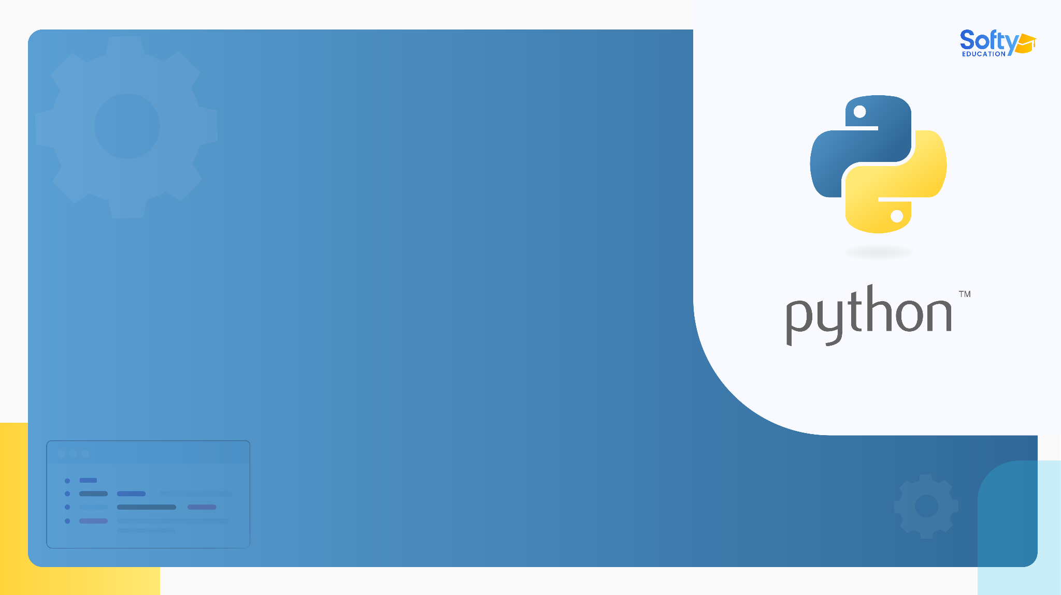
01
Tuples in Python

Slide 5

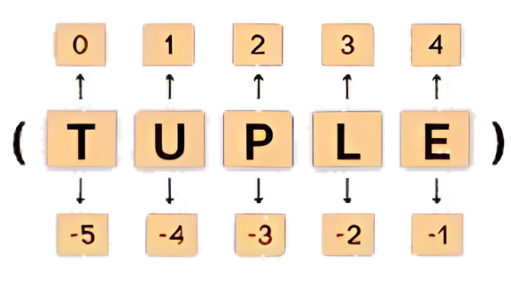
01- Tuples in Python
Tuples are immutable ordered sequences of elements. So, their content cannot be changed after they are created.
‹#›

Slide 6
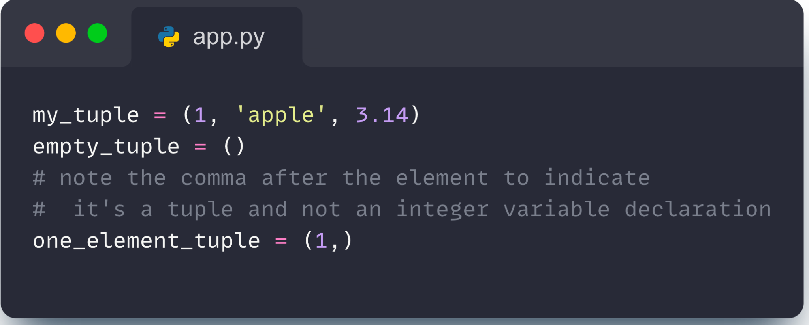
01- Tuples in Python
You can create a tuple by placing a comma-separated sequence of values inside parentheses ().
‹#›

Slide 7
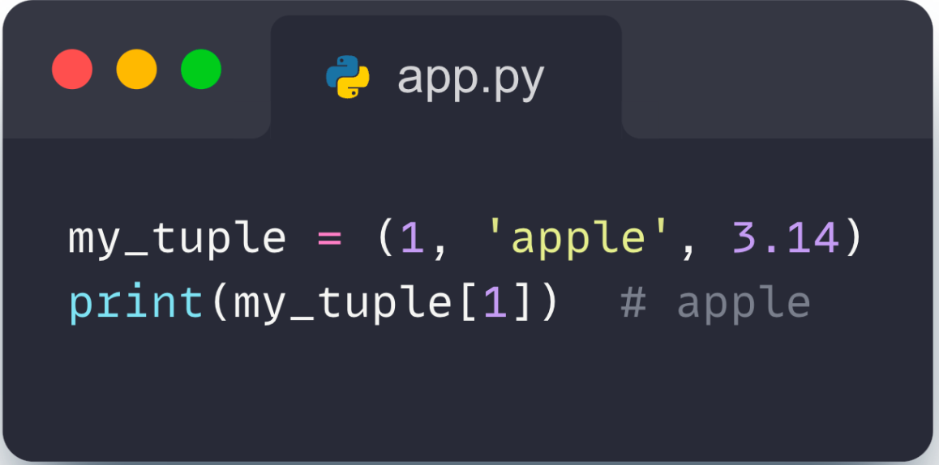
01- Tuples in Python
Accessing Elements
You can access the elements of a tuple using indexing, just like with lists:
‹#›

Slide 8
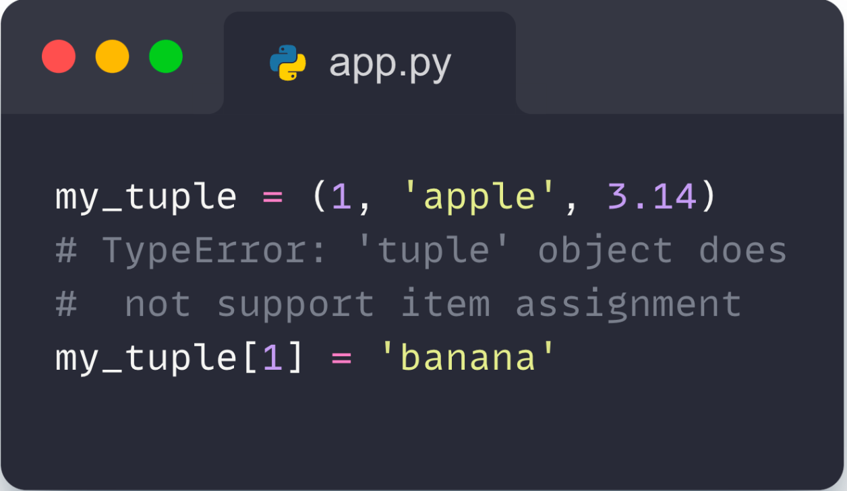
01- Tuples in Python
Immutability
Once a tuple is created, you cannot modify its content. This means that the following code will raise an error:
‹#›

Slide 9
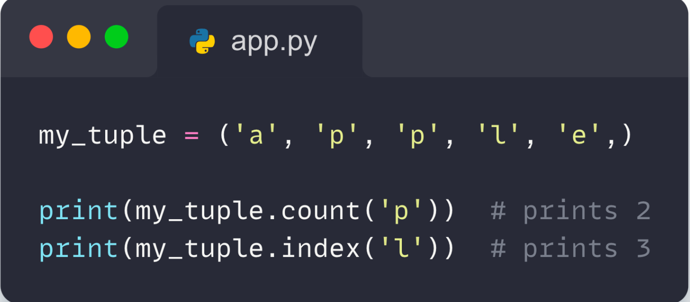
01- Tuples in Python
In Python ,methods that add items or remove items are not available with tuple. Only the following two methods are available. Here,
my_tuple.count('p') - counts total number of 'p' in my_tuple
my_tuple.index('l') - returns the first occurrence of 'l' in my_tuple
‹#›

Slide 10
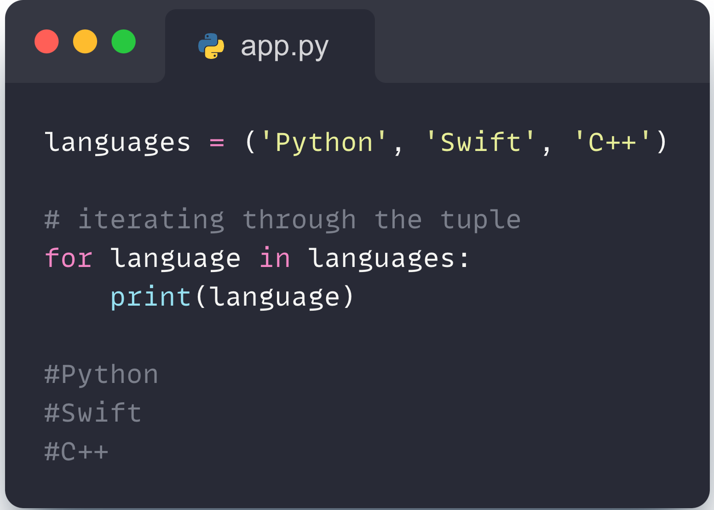
01- Tuples in Python
Iterating through a Tuple in Python :
We can use the for loop to iterate over the elements of a tuple. For example,
‹#›

Slide 11
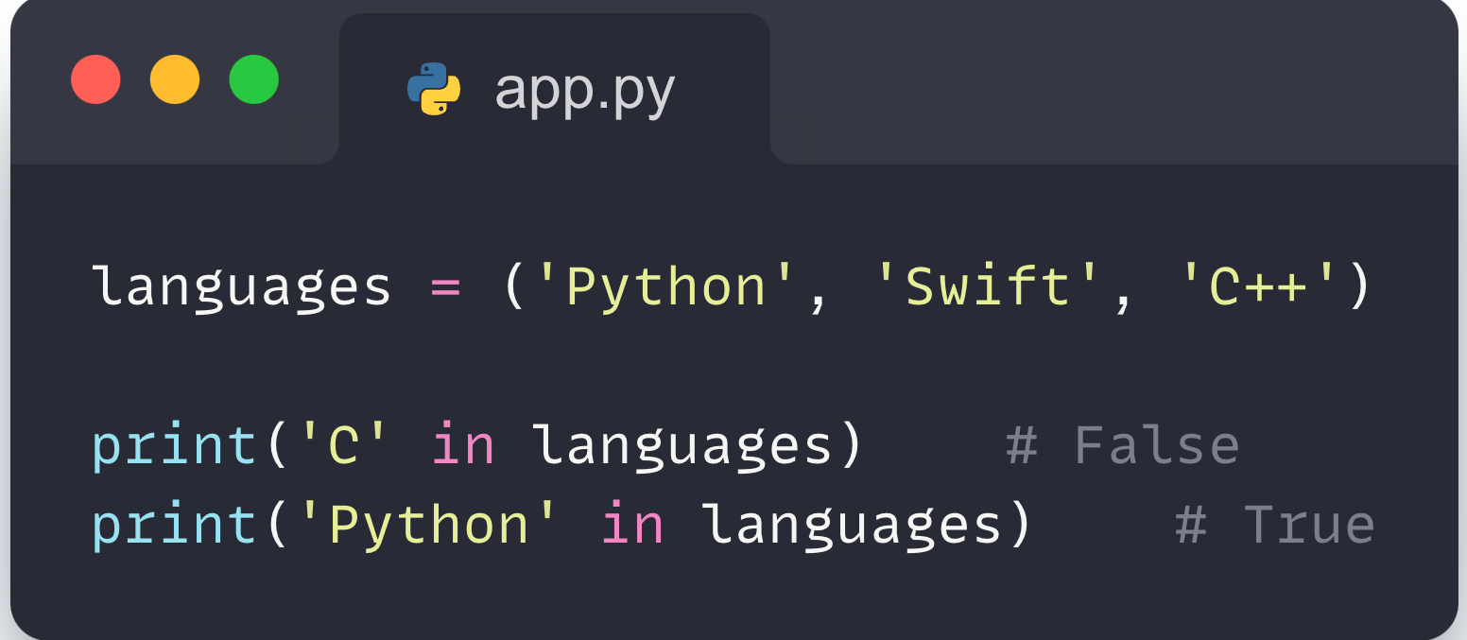
01- Tuples in Python
Check if an Item Exists in the Python Tuple :
We use the in keyword to check if an item exists in the tuple or not. For example,
‹#›

Slide 12
01- Tuples in Python
Advantages of Tuple over List in Python :
Since tuples are quite similar to lists, both of them are used in similar situations. However, there are certain advantages of implementing a tuple over a list:
We generally use tuples for heterogeneous (different) data types and lists for homogeneous (similar) data types.
Since tuples are immutable, iterating through a tuple is faster than with a list. So there is a slight performance boost.
‹#›

Slide 13
02
Sets in Python

Slide 14
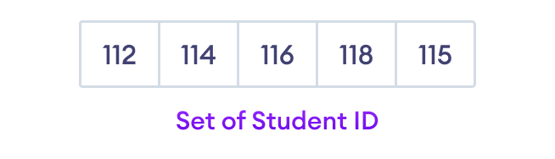
02- Sets in python
A set is a collection of unique data. That is, elements of a set cannot be duplicate. For example,
Suppose we want to store information about student IDs. Since student IDs cannot be duplicate, we can use a set.
‹#›

Slide 15
02- Sets in python
Create a Set in Python :
In Python, we create sets by placing all the elements inside curly braces {}, separated by comma.
A set can have elements with different types (integer, float, tuple, string etc.). But a set cannot have mutable elements like lists, sets or dictionaries .
‹#›

Slide 16
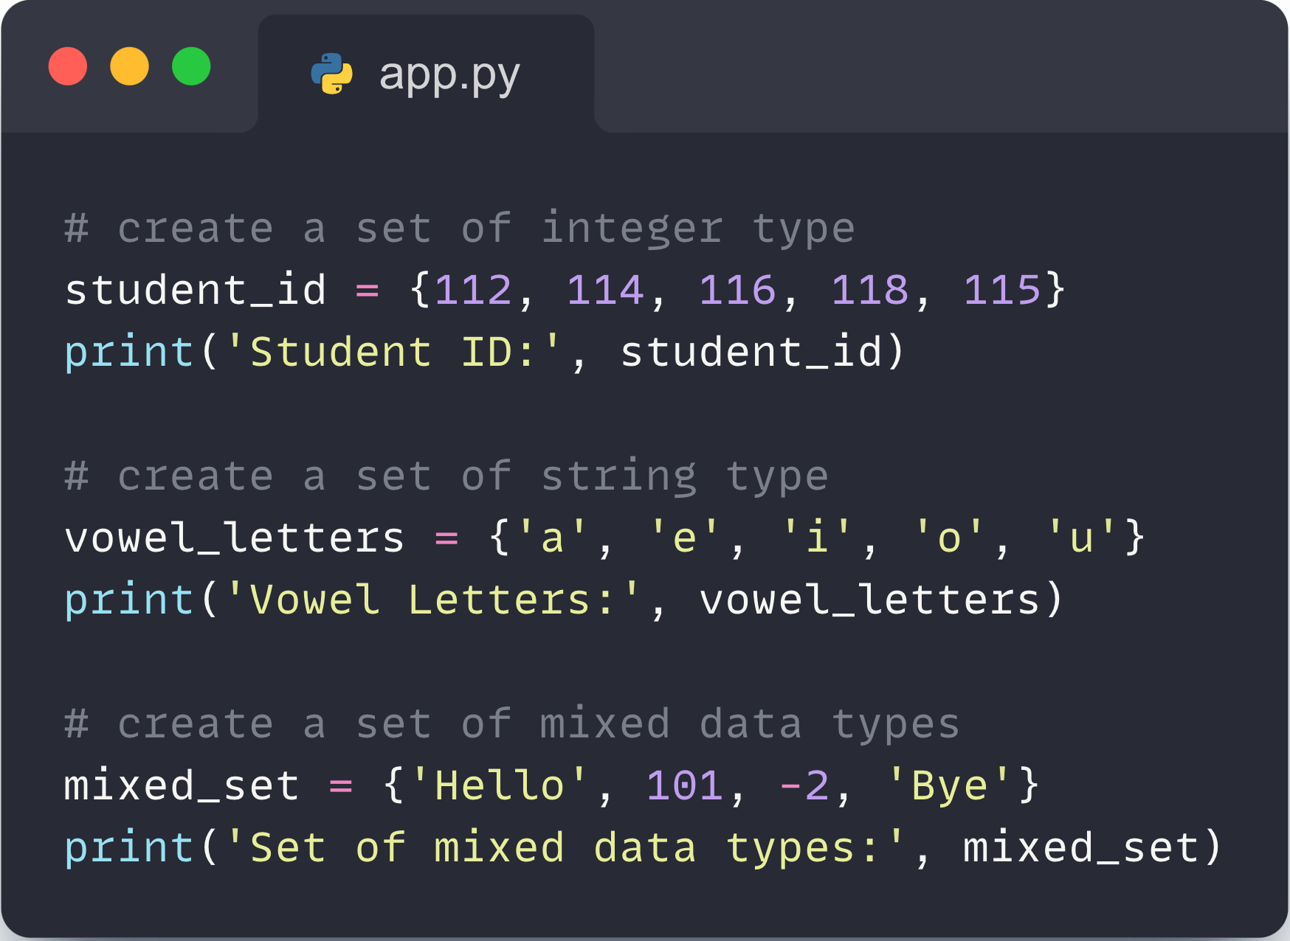
02- Sets in python
Examples :
‹#›

Slide 17
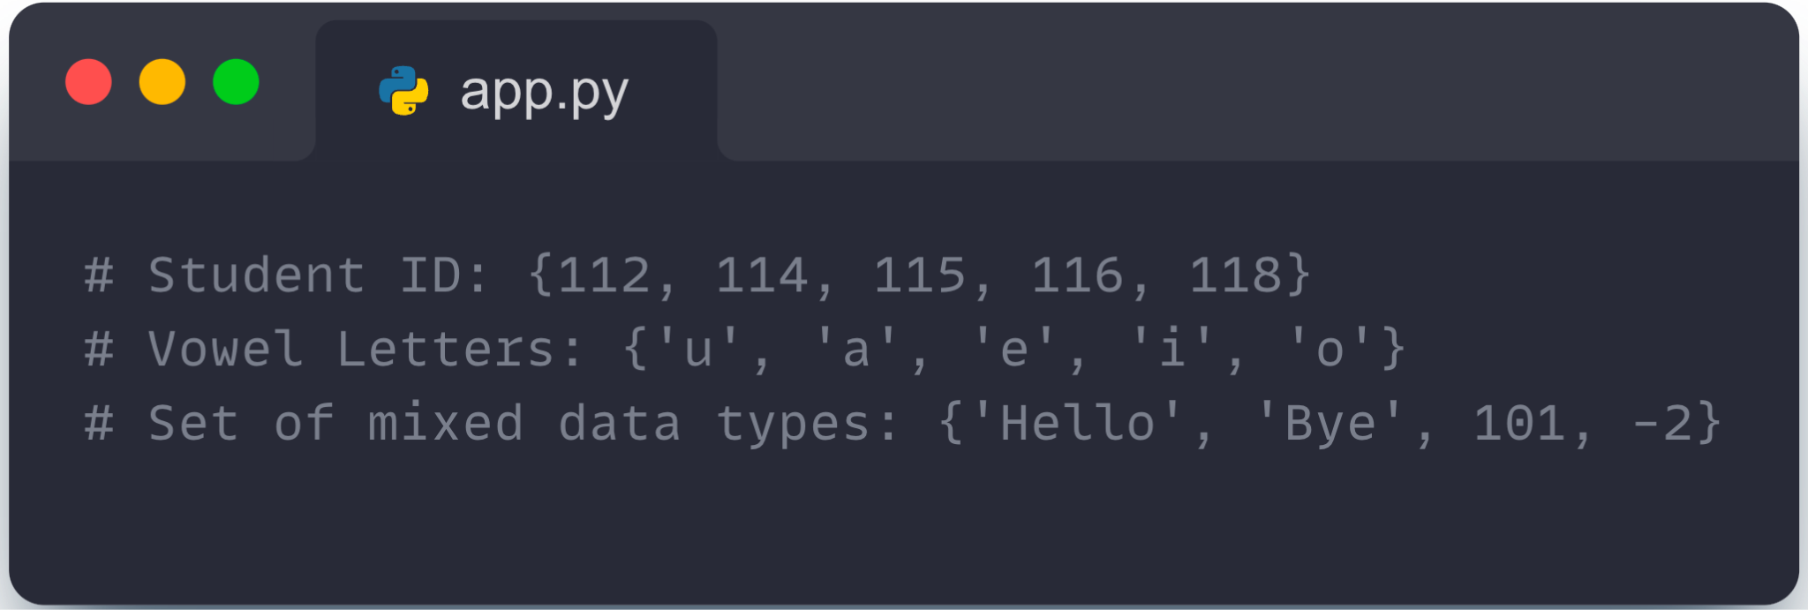
02- Sets in python
Output :
‹#›

Slide 18
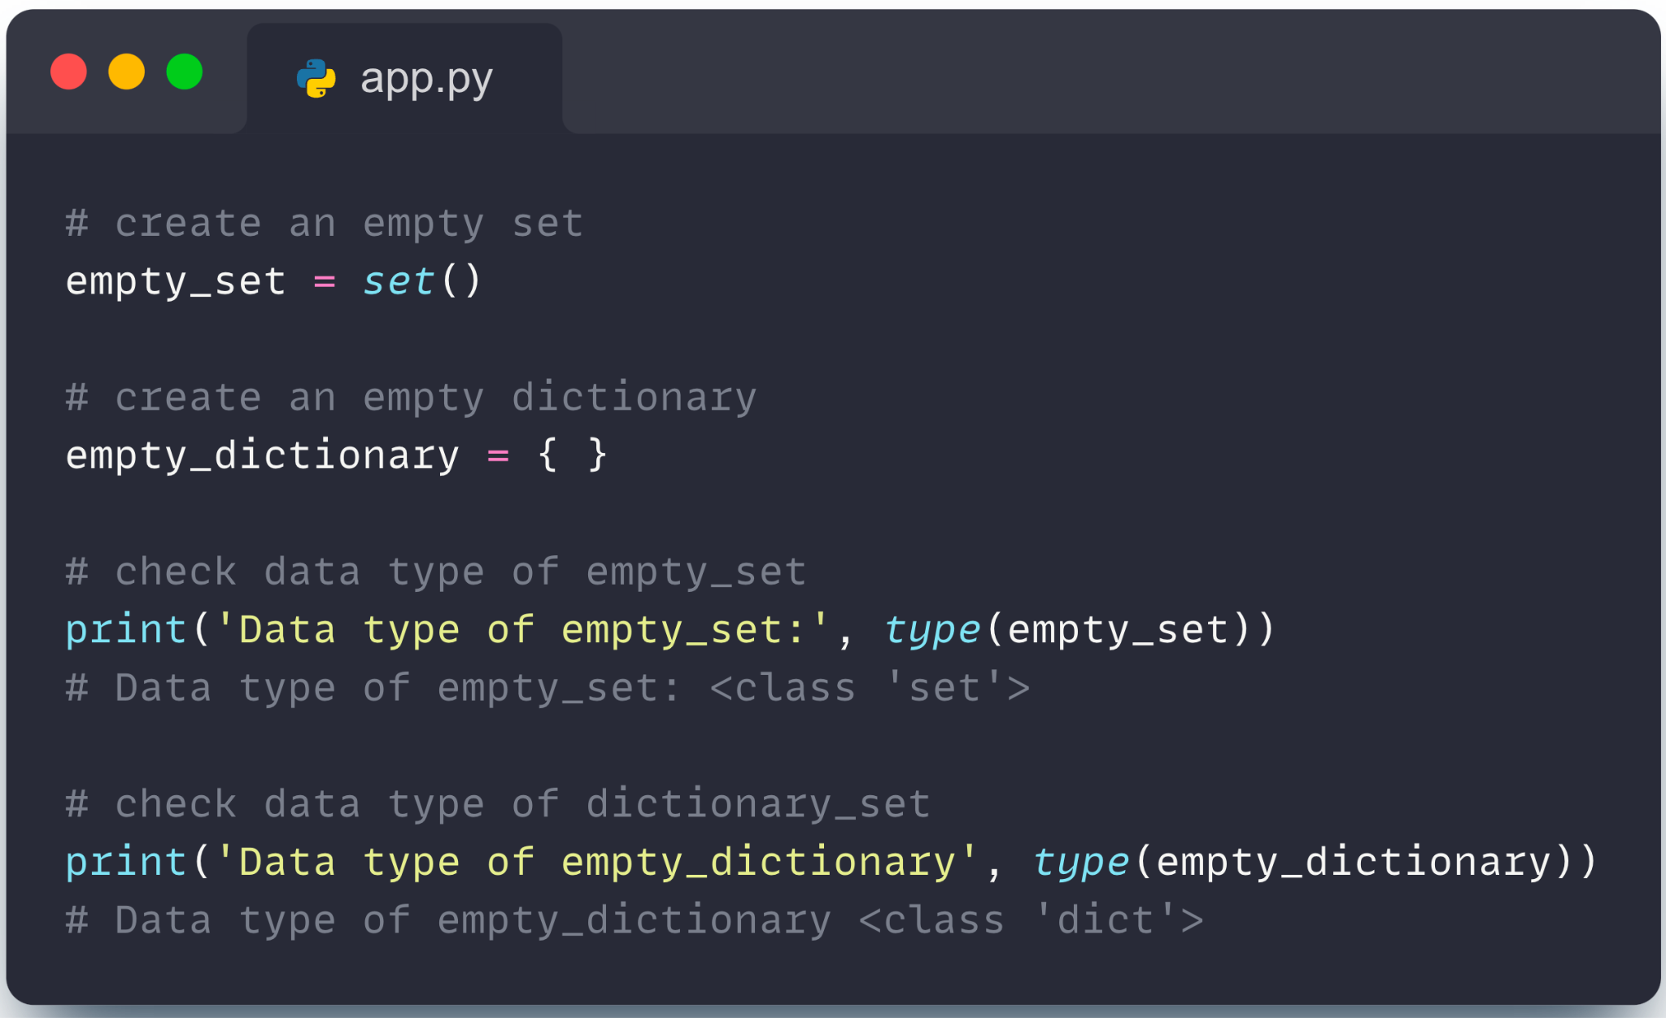
02- Sets in python
Create an Empty Set in Python :
Creating an empty set is a bit tricky. Empty curly braces {} will make an empty dictionary in Python.
To make a set without any elements, we use set() .
‹#›

Slide 19
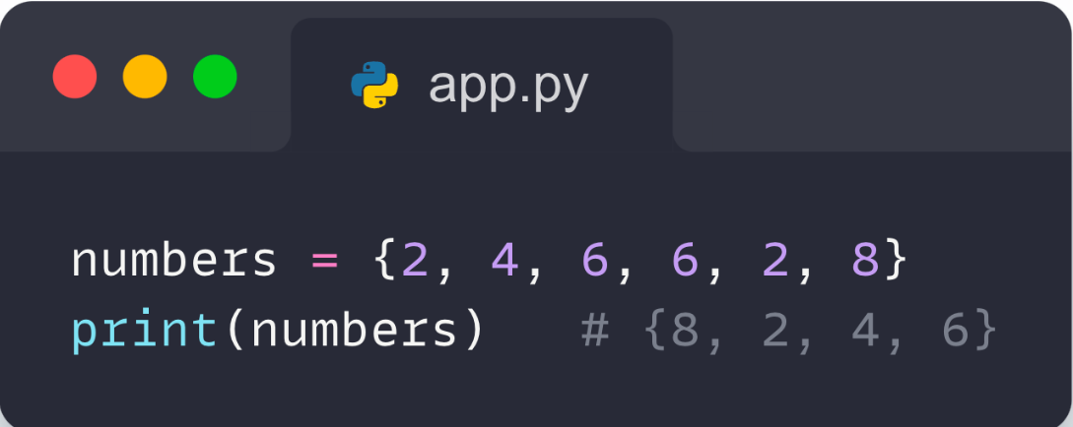
02- Sets in python
Duplicate Items in a Set :
Let's see what will happen if we try to include duplicate items in a set.
‹#›

Slide 20
02- Sets in python
Add and Update Set Items in Python :
Sets are mutable. However, since they are unordered, indexing has no meaning.
We cannot access or change an element of a set using indexing or slicing.
‹#›

Slide 21
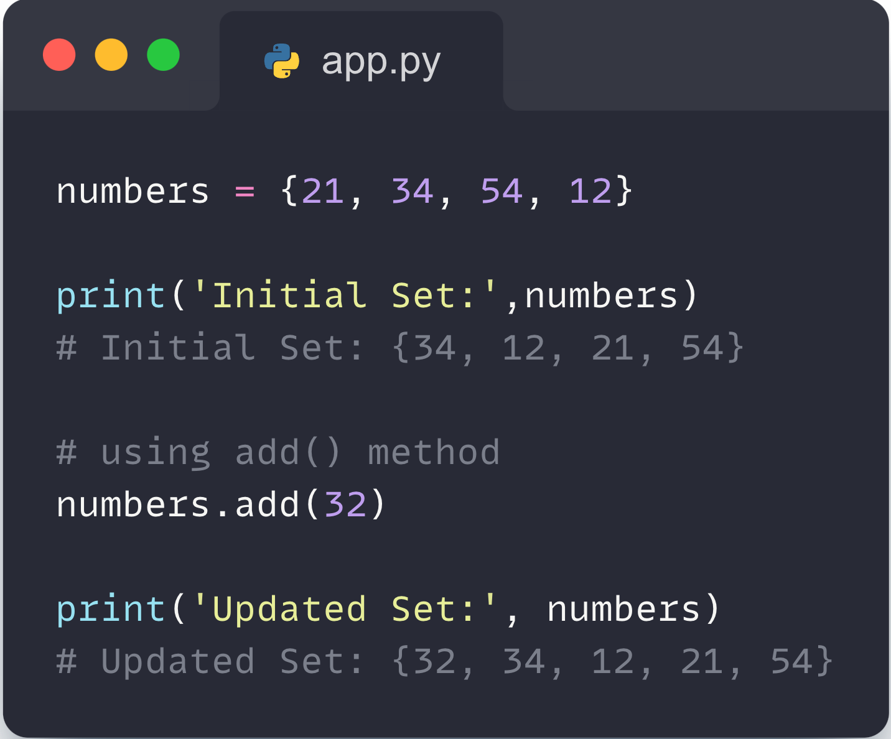
02- Sets in python
Add Items to a Set in Python :
In Python, we use the add() method to add an item to a set. For example,
‹#›

Slide 22
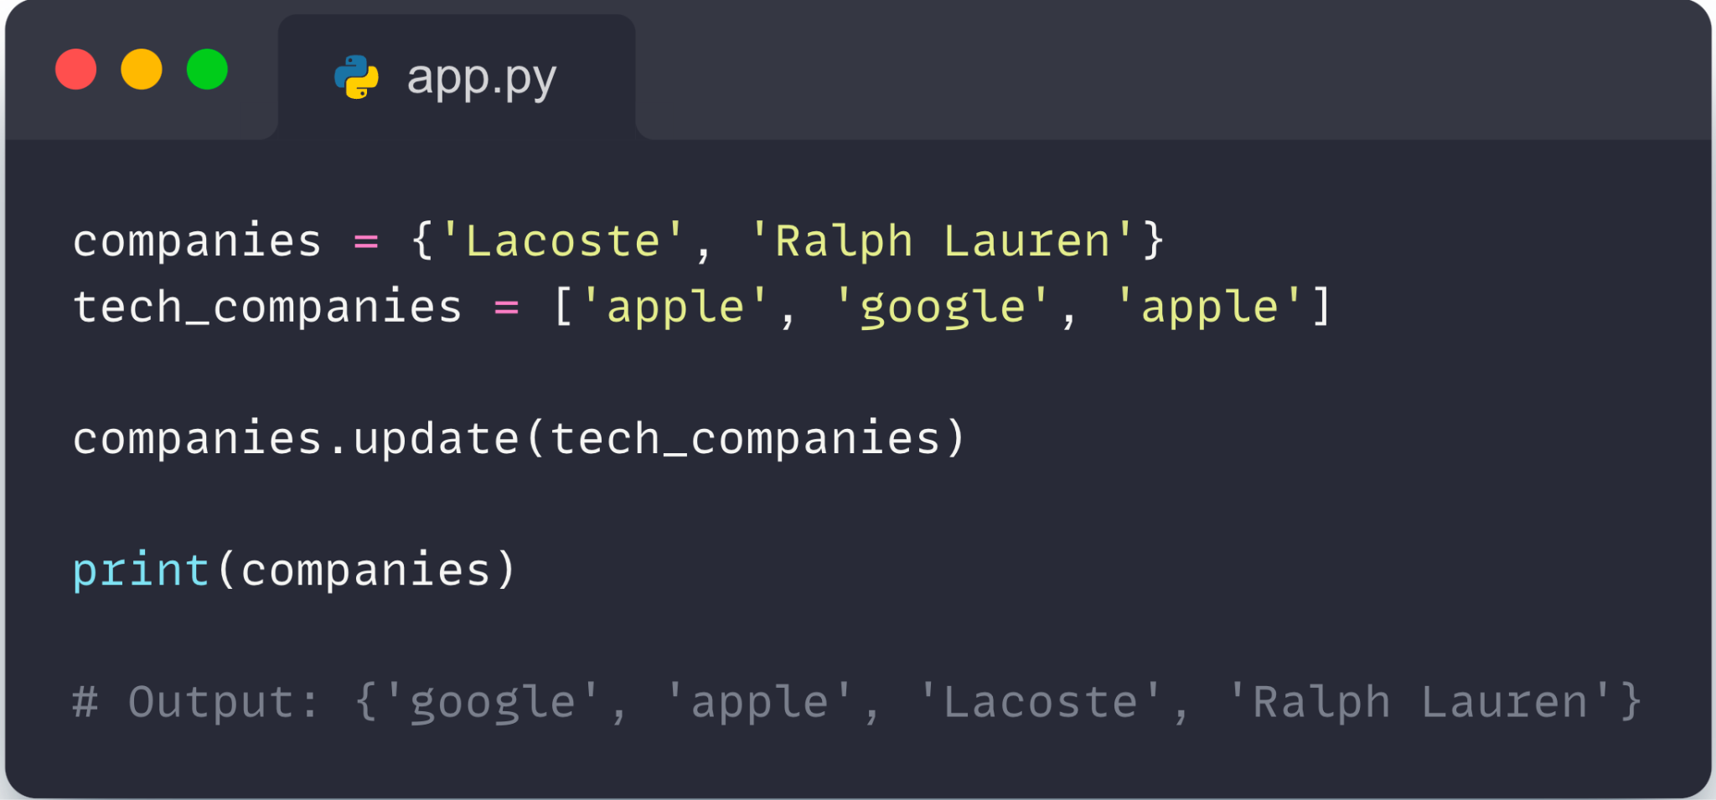
02- Sets in python
2. Update Python Set :
The update() method is used to update the set with items other collection types (lists, tuples, sets, etc). For example,
‹#›

Slide 23
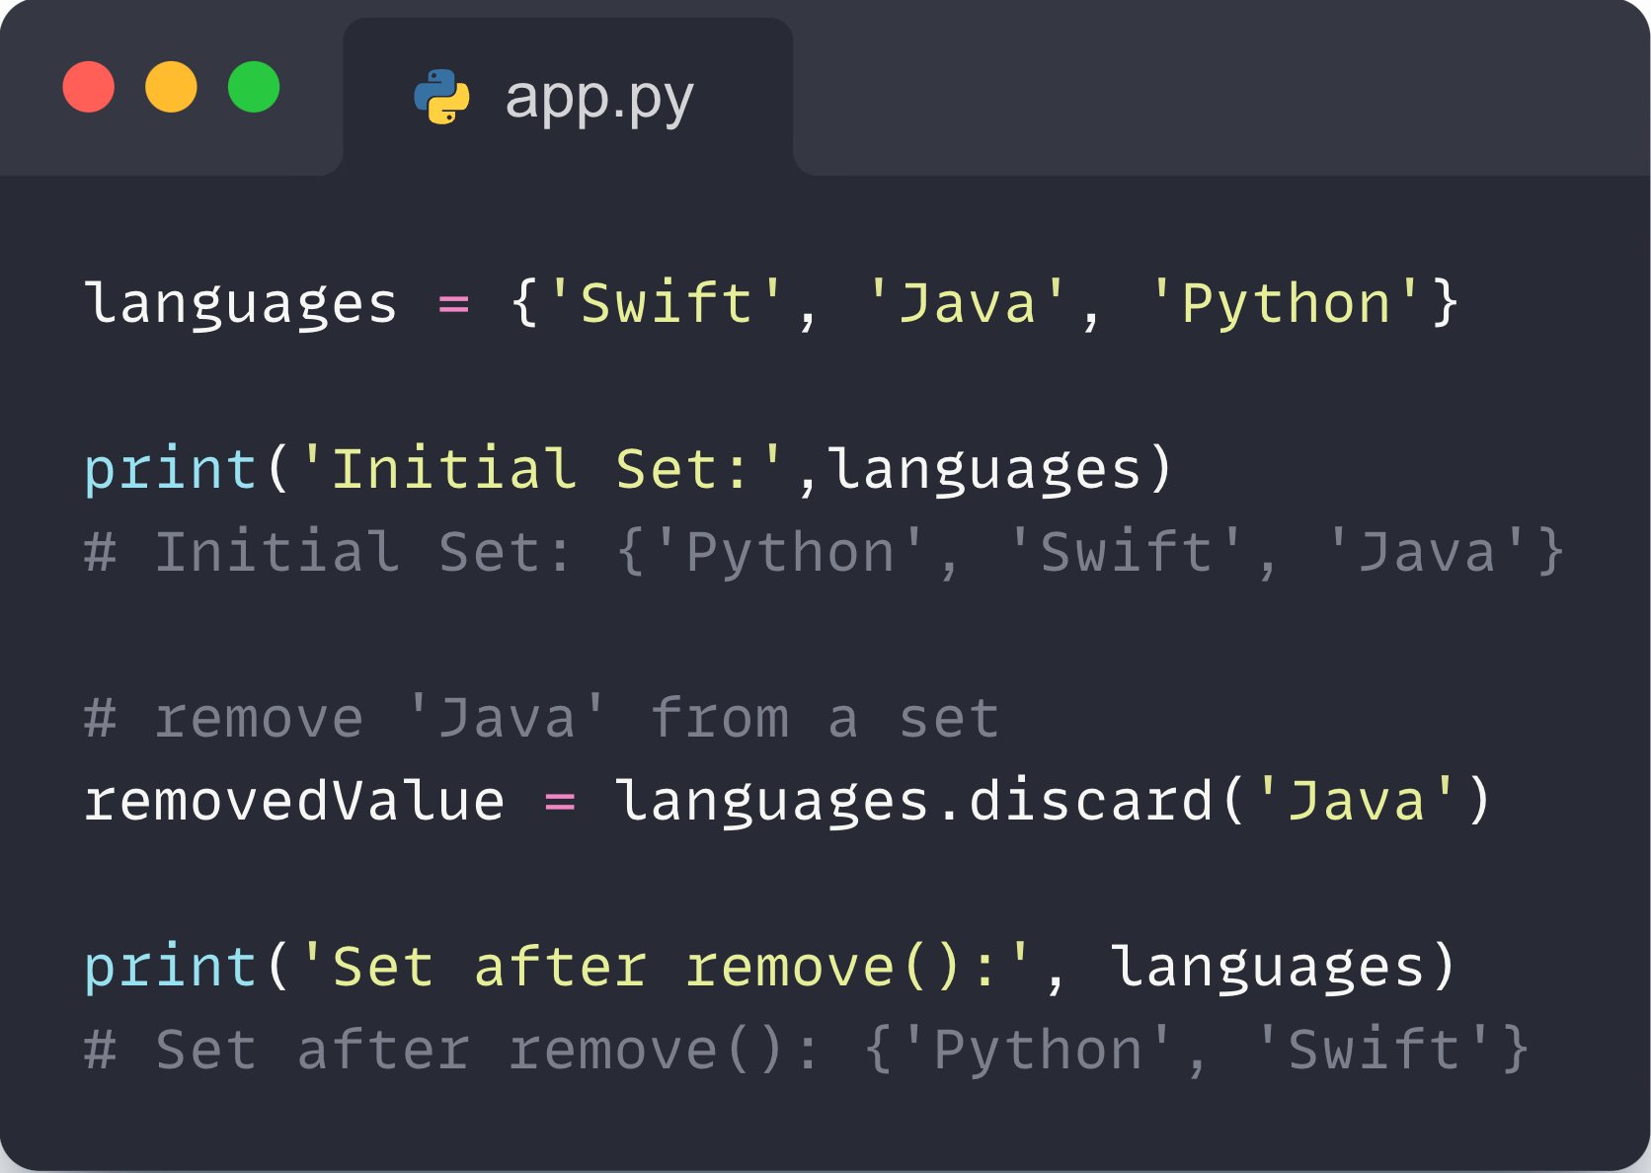
02- Sets in python
3. Remove an Element from a Set :
We use the discard() method to remove the specified element from a set. For example,
‹#›

Slide 24
02- Sets in python
4. Built-in Functions with Set :
Built-in functions like all(), any(), enumerate(), len(), max(), min(), sorted(), sum() etc. are commonly used with sets to perform different tasks.
‹#›

Slide 25
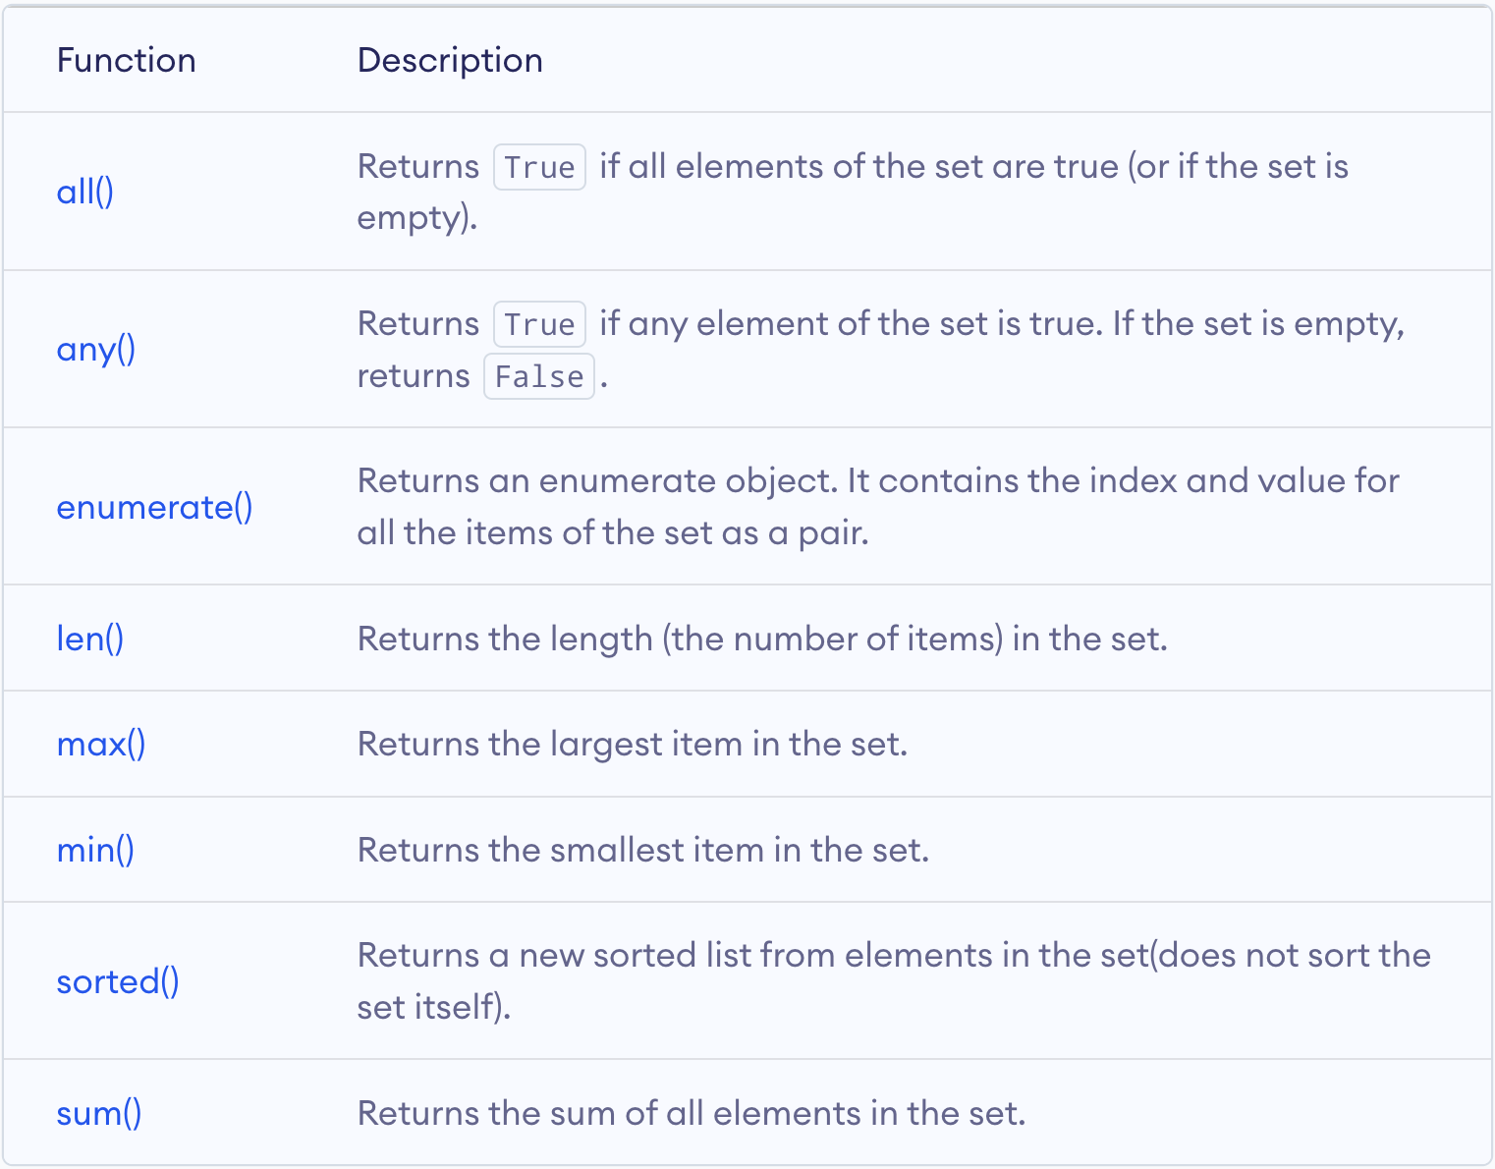
02- Sets in python
‹#›

Slide 26
03
Lists in Python

Slide 27

03- Lists in python
In Python, lists are used to store multiple data at once.
Suppose we need to record the ages of 5 students. Instead of creating 5 separate variables, we can simply create a list.
‹#›

Slide 28
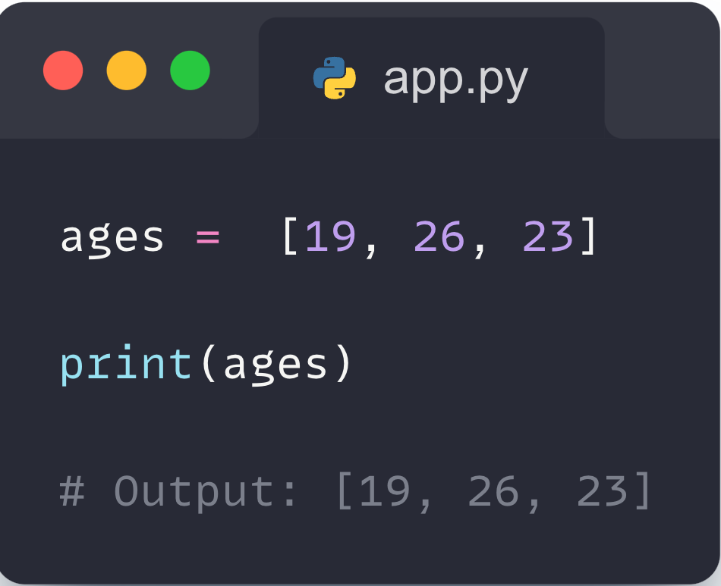
03- Lists in python
Create a List :
We create a list by placing elements inside [], separated by commas. For example,
‹#›

Slide 29
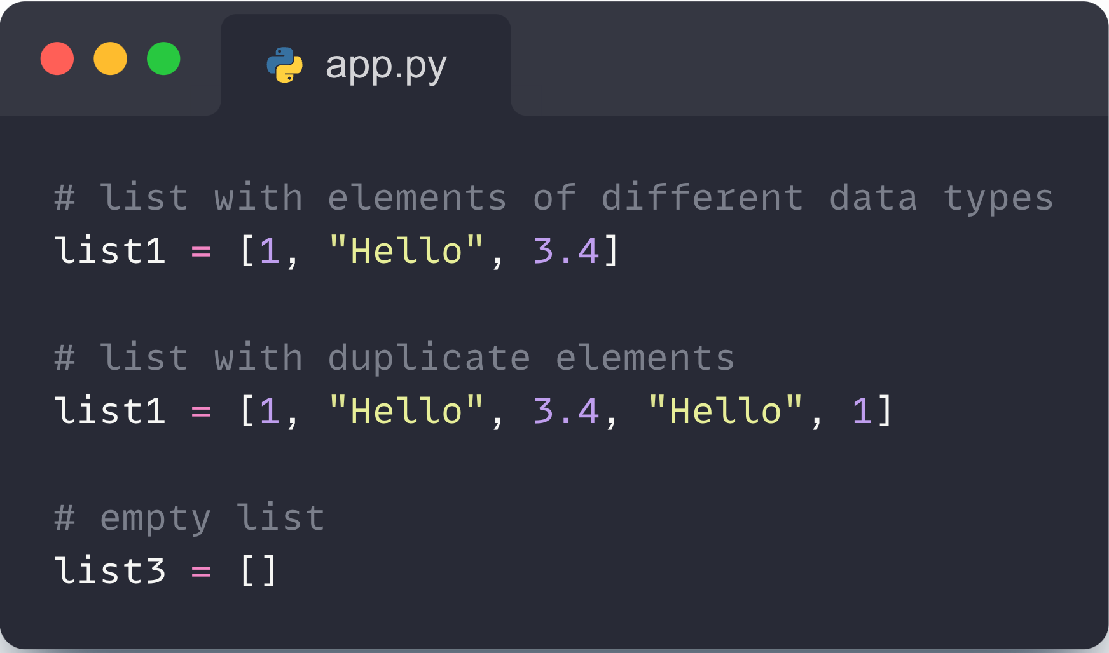
03- Lists in python
A list can :
store elements of different types (integer, float, string, etc.)
store duplicate elements
‹#›

Slide 30
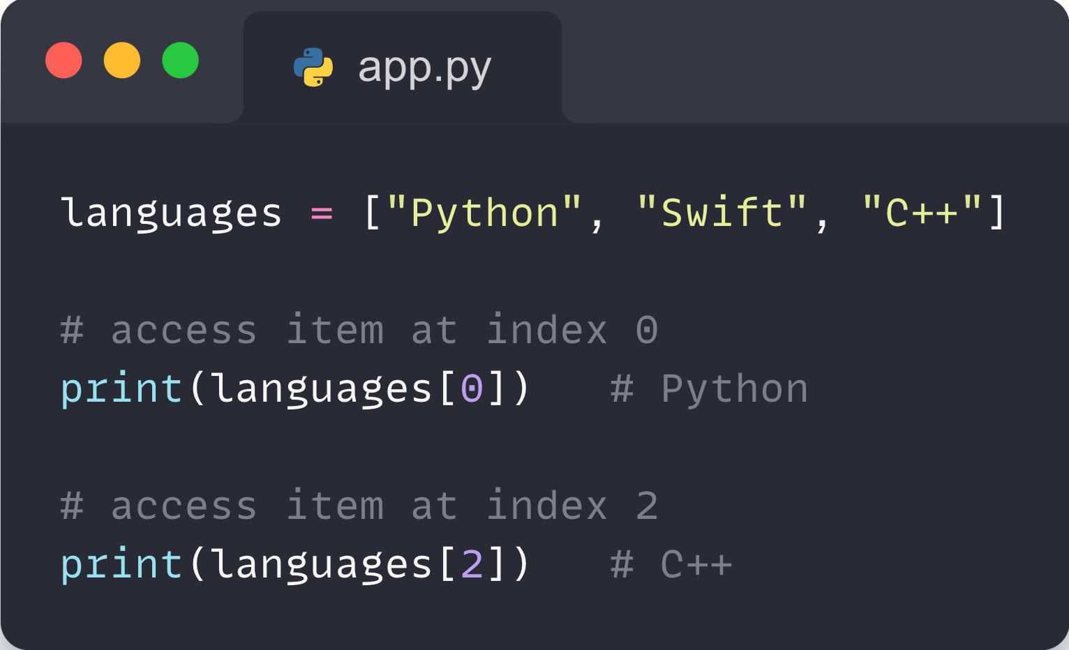
03- Lists in python
Access List Elements :
In Python, lists are ordered and each item in a list is associated with a number. The number is known as a list index.
The index of the first element is 0, second element is 1 and so on. For example,
‹#›

Slide 31
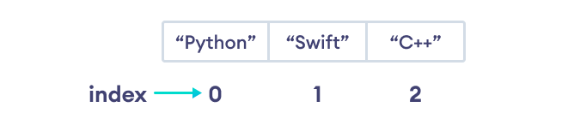
03- Lists in python
In the above example, we have created a list named languages.
‹#›

Slide 32
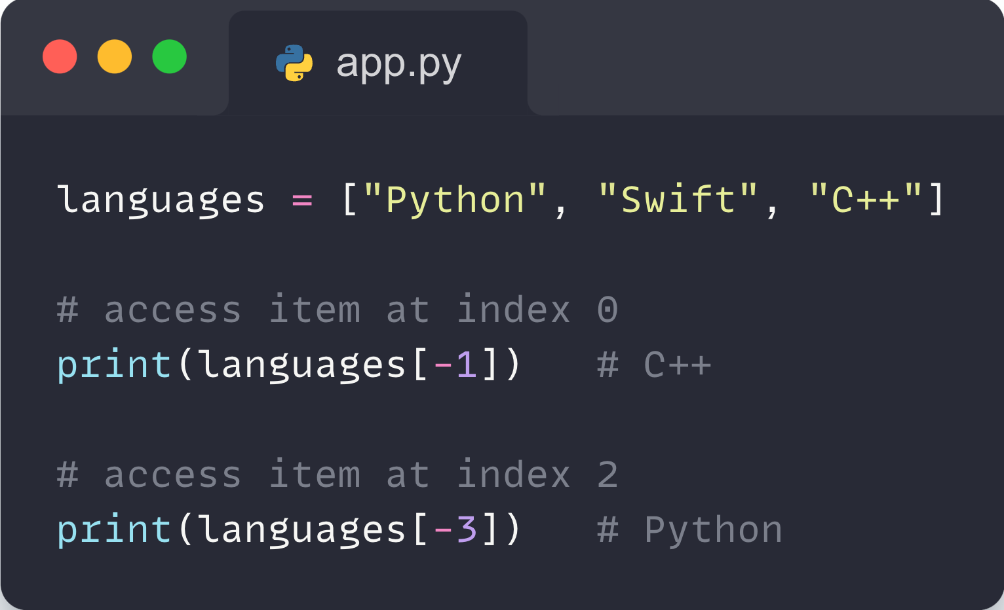
03- Lists in python
Negative Indexing in Python :
Python allows negative indexing for its sequences. The index of -1 refers to the last item, -2 to the second last item and so on.
‹#›

Slide 33
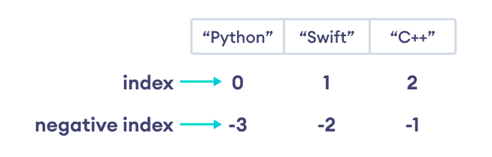
03- Lists in python
Negative Indexing in Python :
‹#›

Slide 34
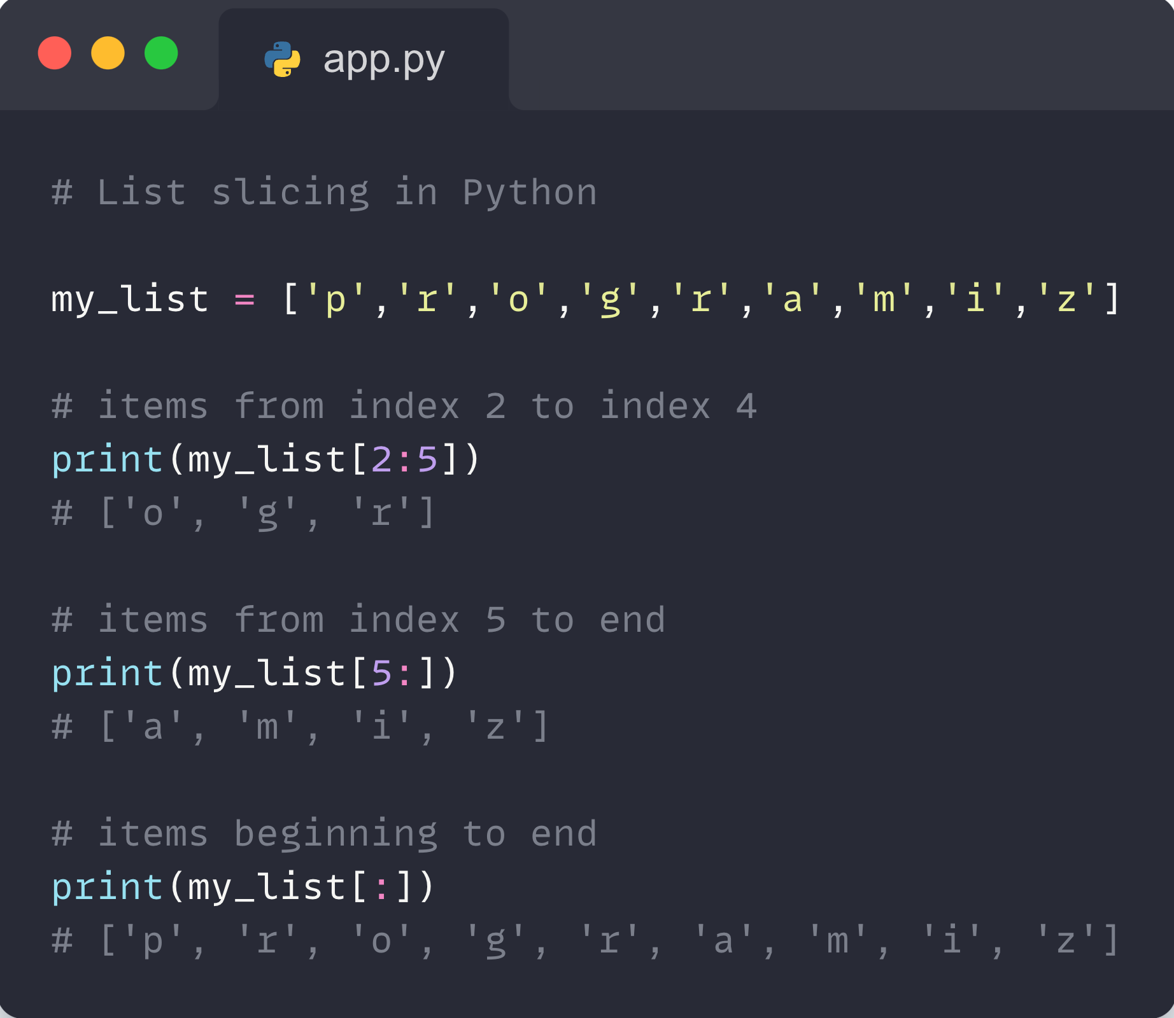
03- Lists in python
Slicing of a List :
In Python, it is possible to access a portion of a list using the slicing operator :
For example,
‹#›

Slide 35
03- Lists in python
Add Elements to a List :
Lists are mutable (changeable). Meaning we can add and remove elements from a list.
‹#›

Slide 36
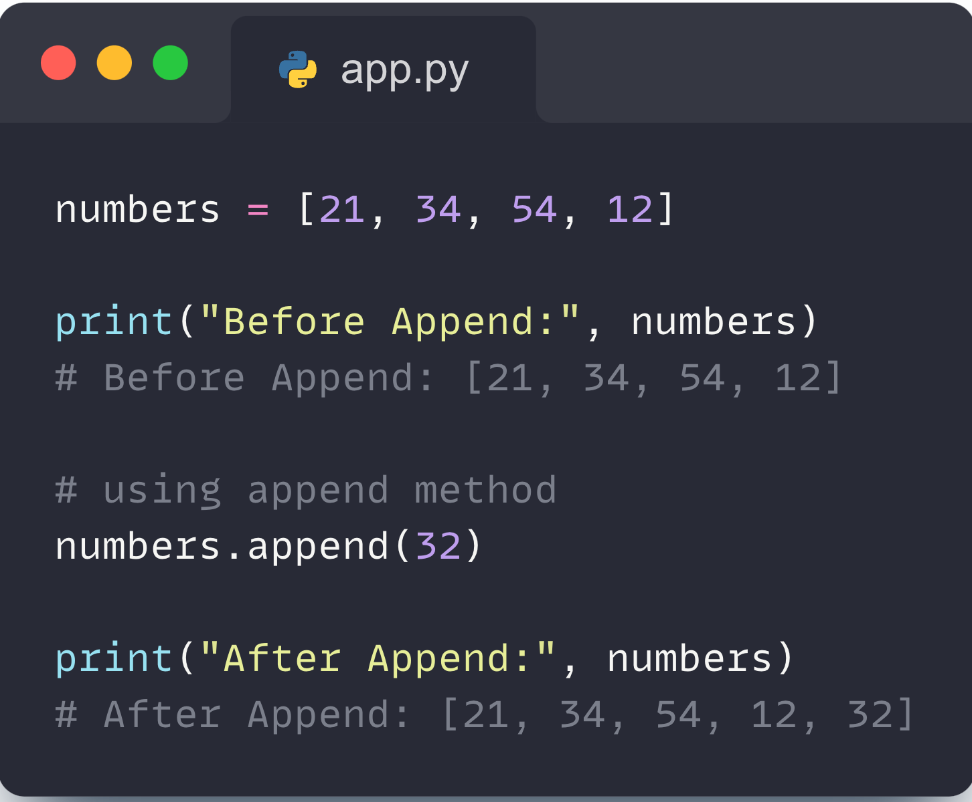
03- Lists in python
Using append() :
The append() method adds an item at the end of the list. For example,
‹#›

Slide 37
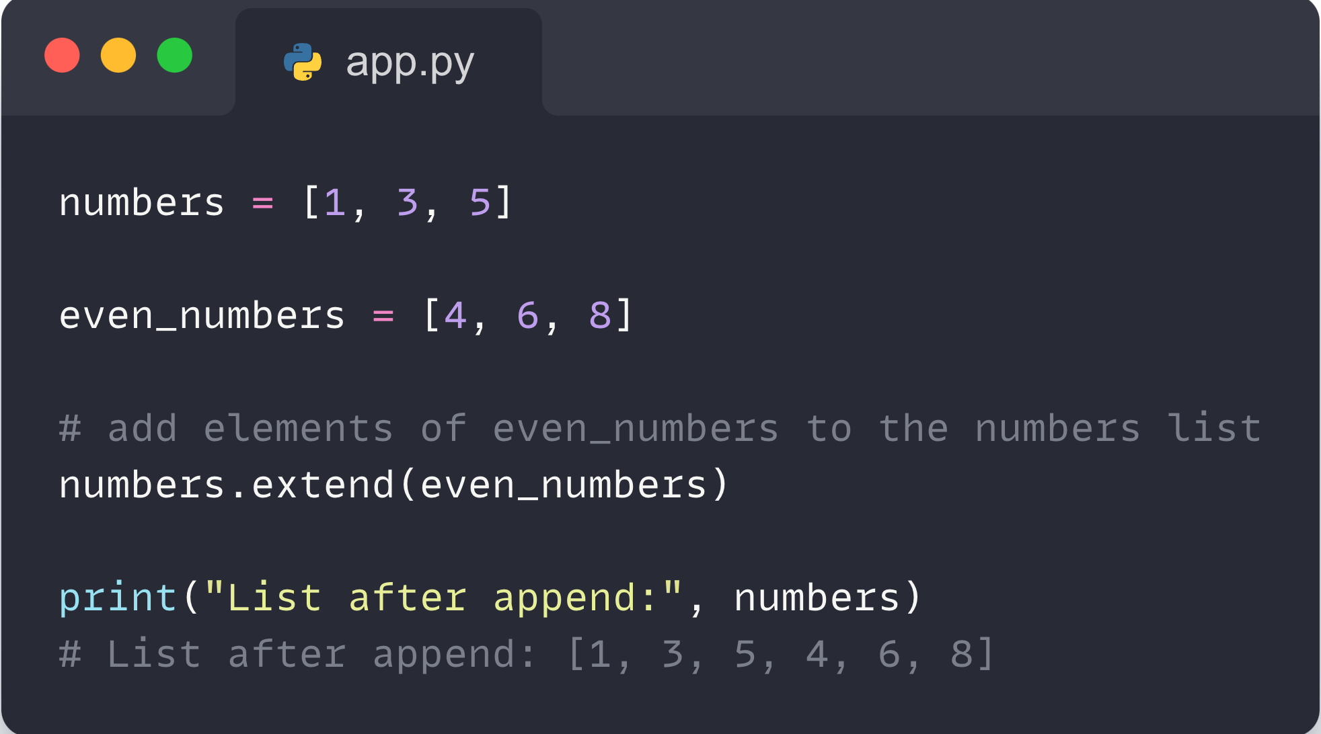
03- Lists in python
2. Using extend() :
We use the extend() method to add all the items of an iterable (list, tuple, string, dictionary, etc.) to the end of the list. For example,
‹#›

Slide 38
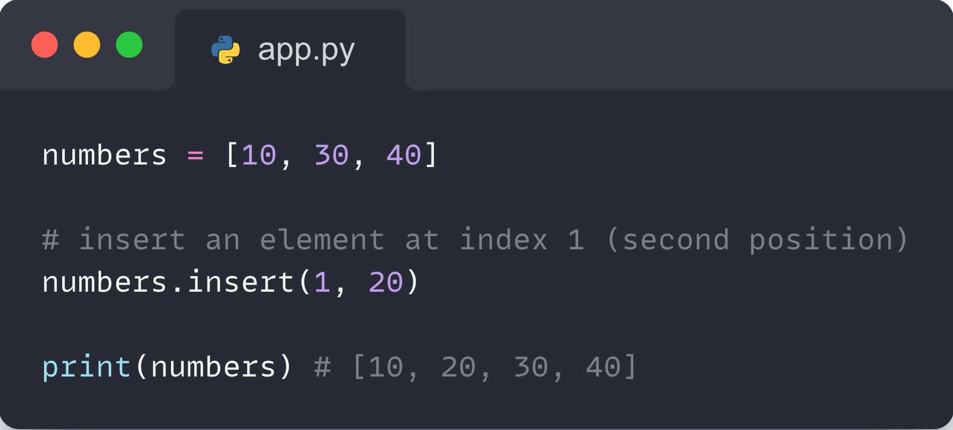
03- Lists in python
3. Using insert() :
We use the insert() method to add an element at the specified index.
‹#›

Slide 39
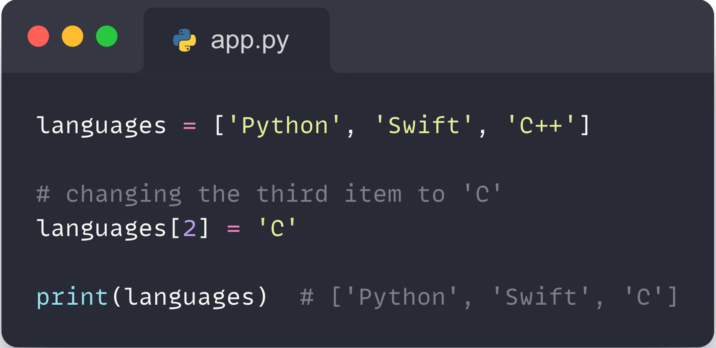
03- Lists in python
Change List Items :
Python lists are mutable. Meaning lists are changeable. And we can change items of a list by assigning new values using the = operator. For example,
‹#›

Slide 40
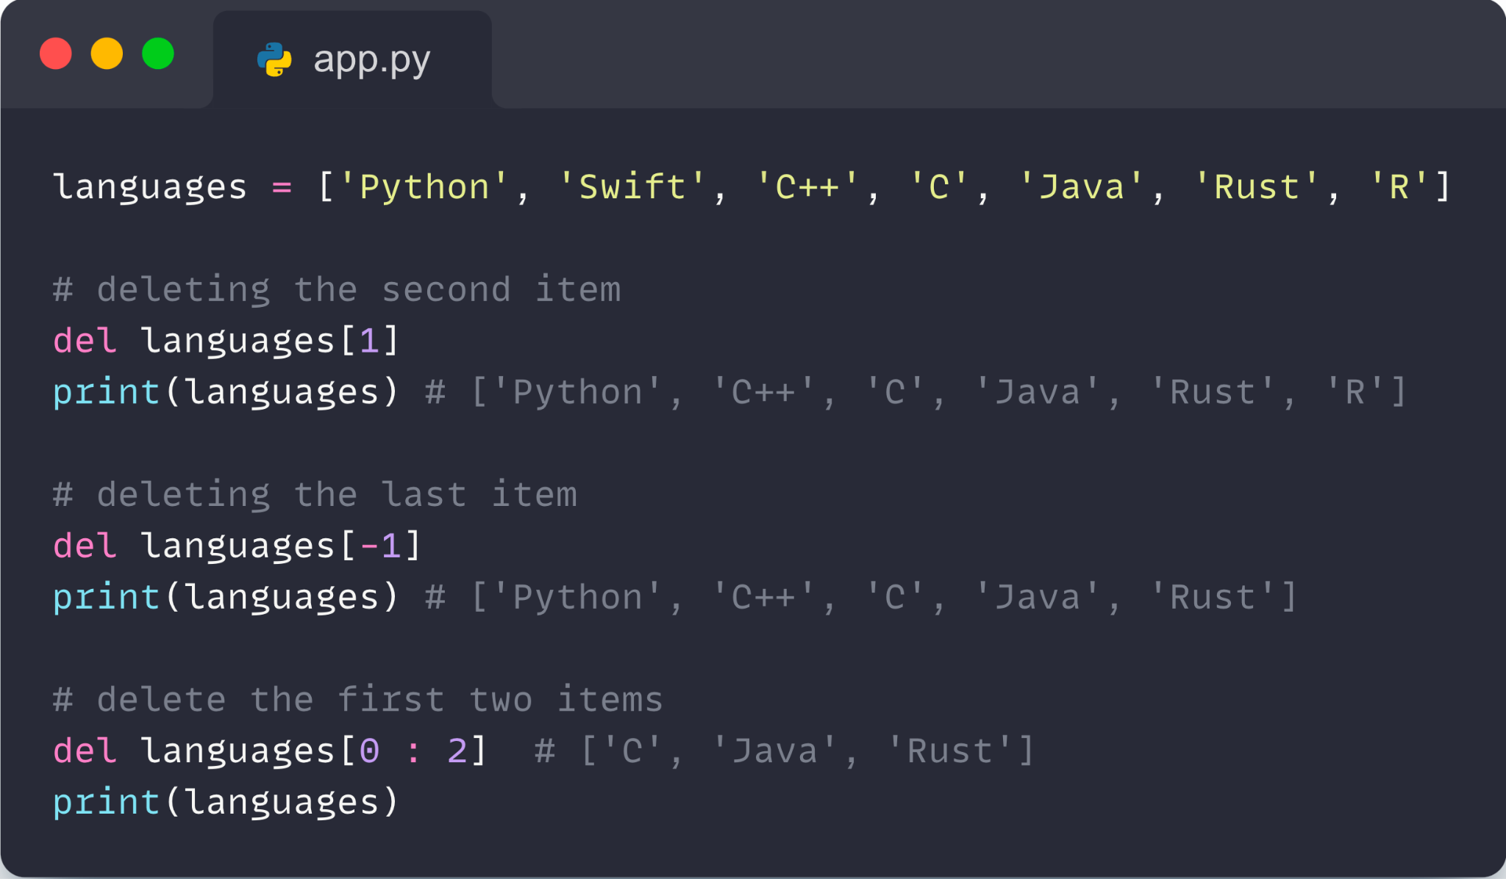
03- Lists in python
Remove an Item From a List :
Using del Statement :
In Python we can use the del statement to remove one or more items from a list. For example,
‹#›

Slide 41
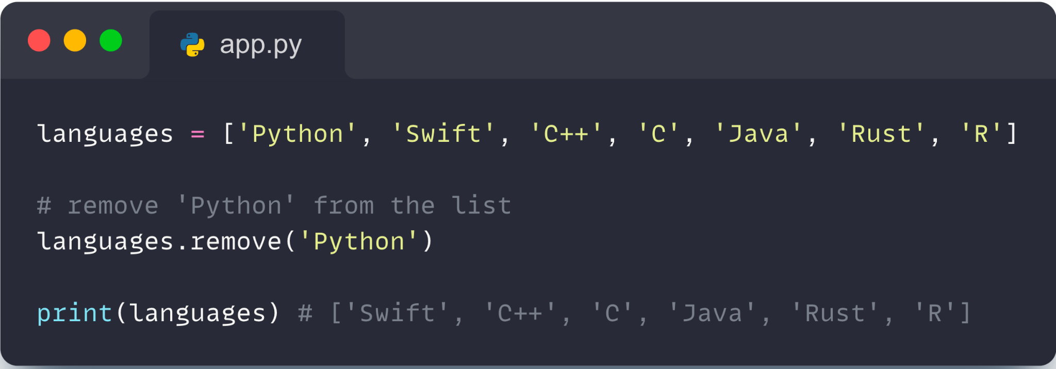
03- Lists in python
2. Using remove Statement :
We can also use the remove() method to delete a list item. For example,
‹#›

Slide 42
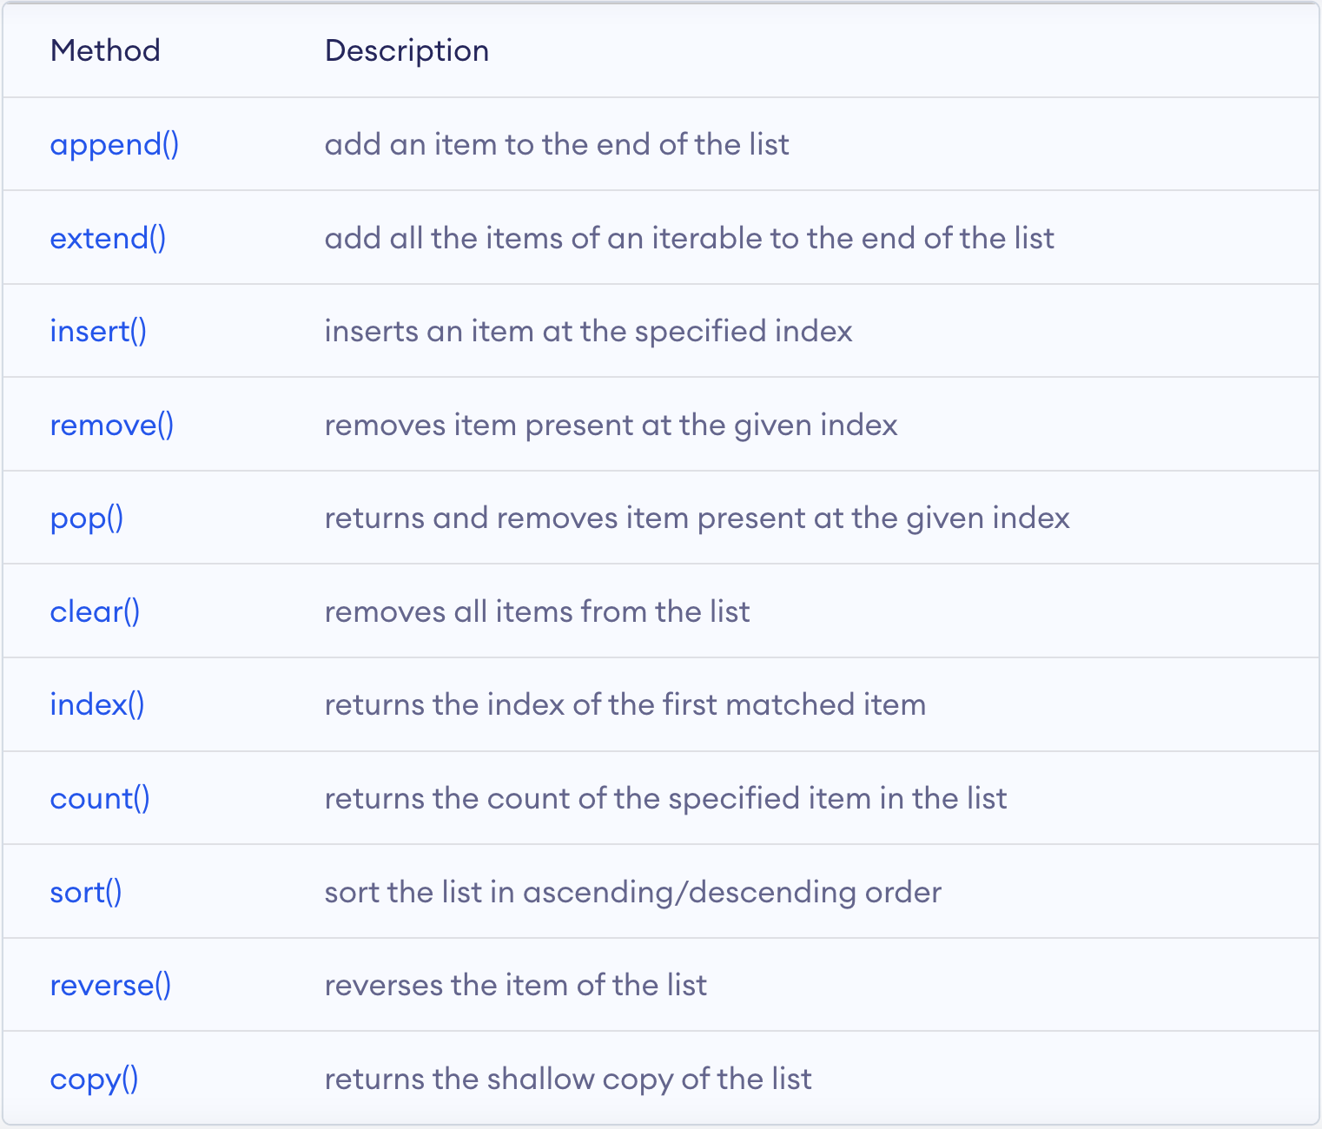
03- Lists in python
List Methods :
‹#›

Slide 43
04
Dictionaries
in Python

Slide 44
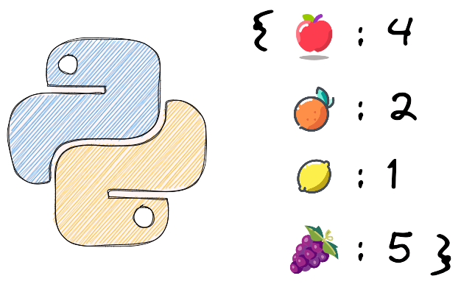
04- Dictionaries in python
In Python, a dictionary is a collection that allows us to store data in key-value pairs.
‹#›

Slide 45
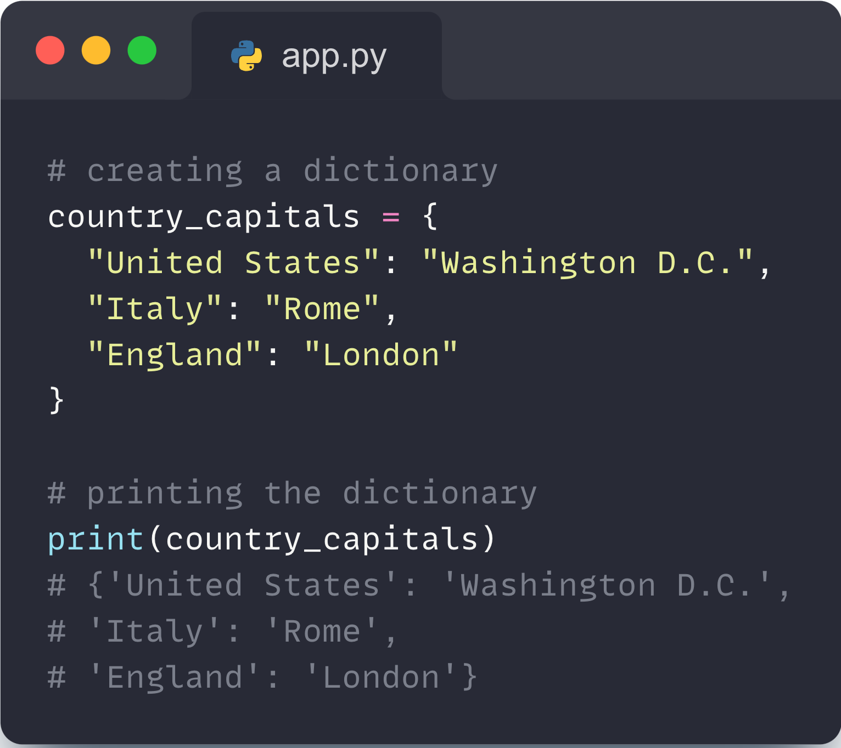
04- Dictionaries in python
Create a Dictionary :
We create dictionaries by placing key:value pairs inside curly brackets {}, separated by commas. For example,
‹#›

Slide 46
04- Dictionaries in python
Create a Dictionary :
We create dictionaries by placing key:value pairs inside curly brackets {}, separated by commas. For example,
‹#›

Slide 47
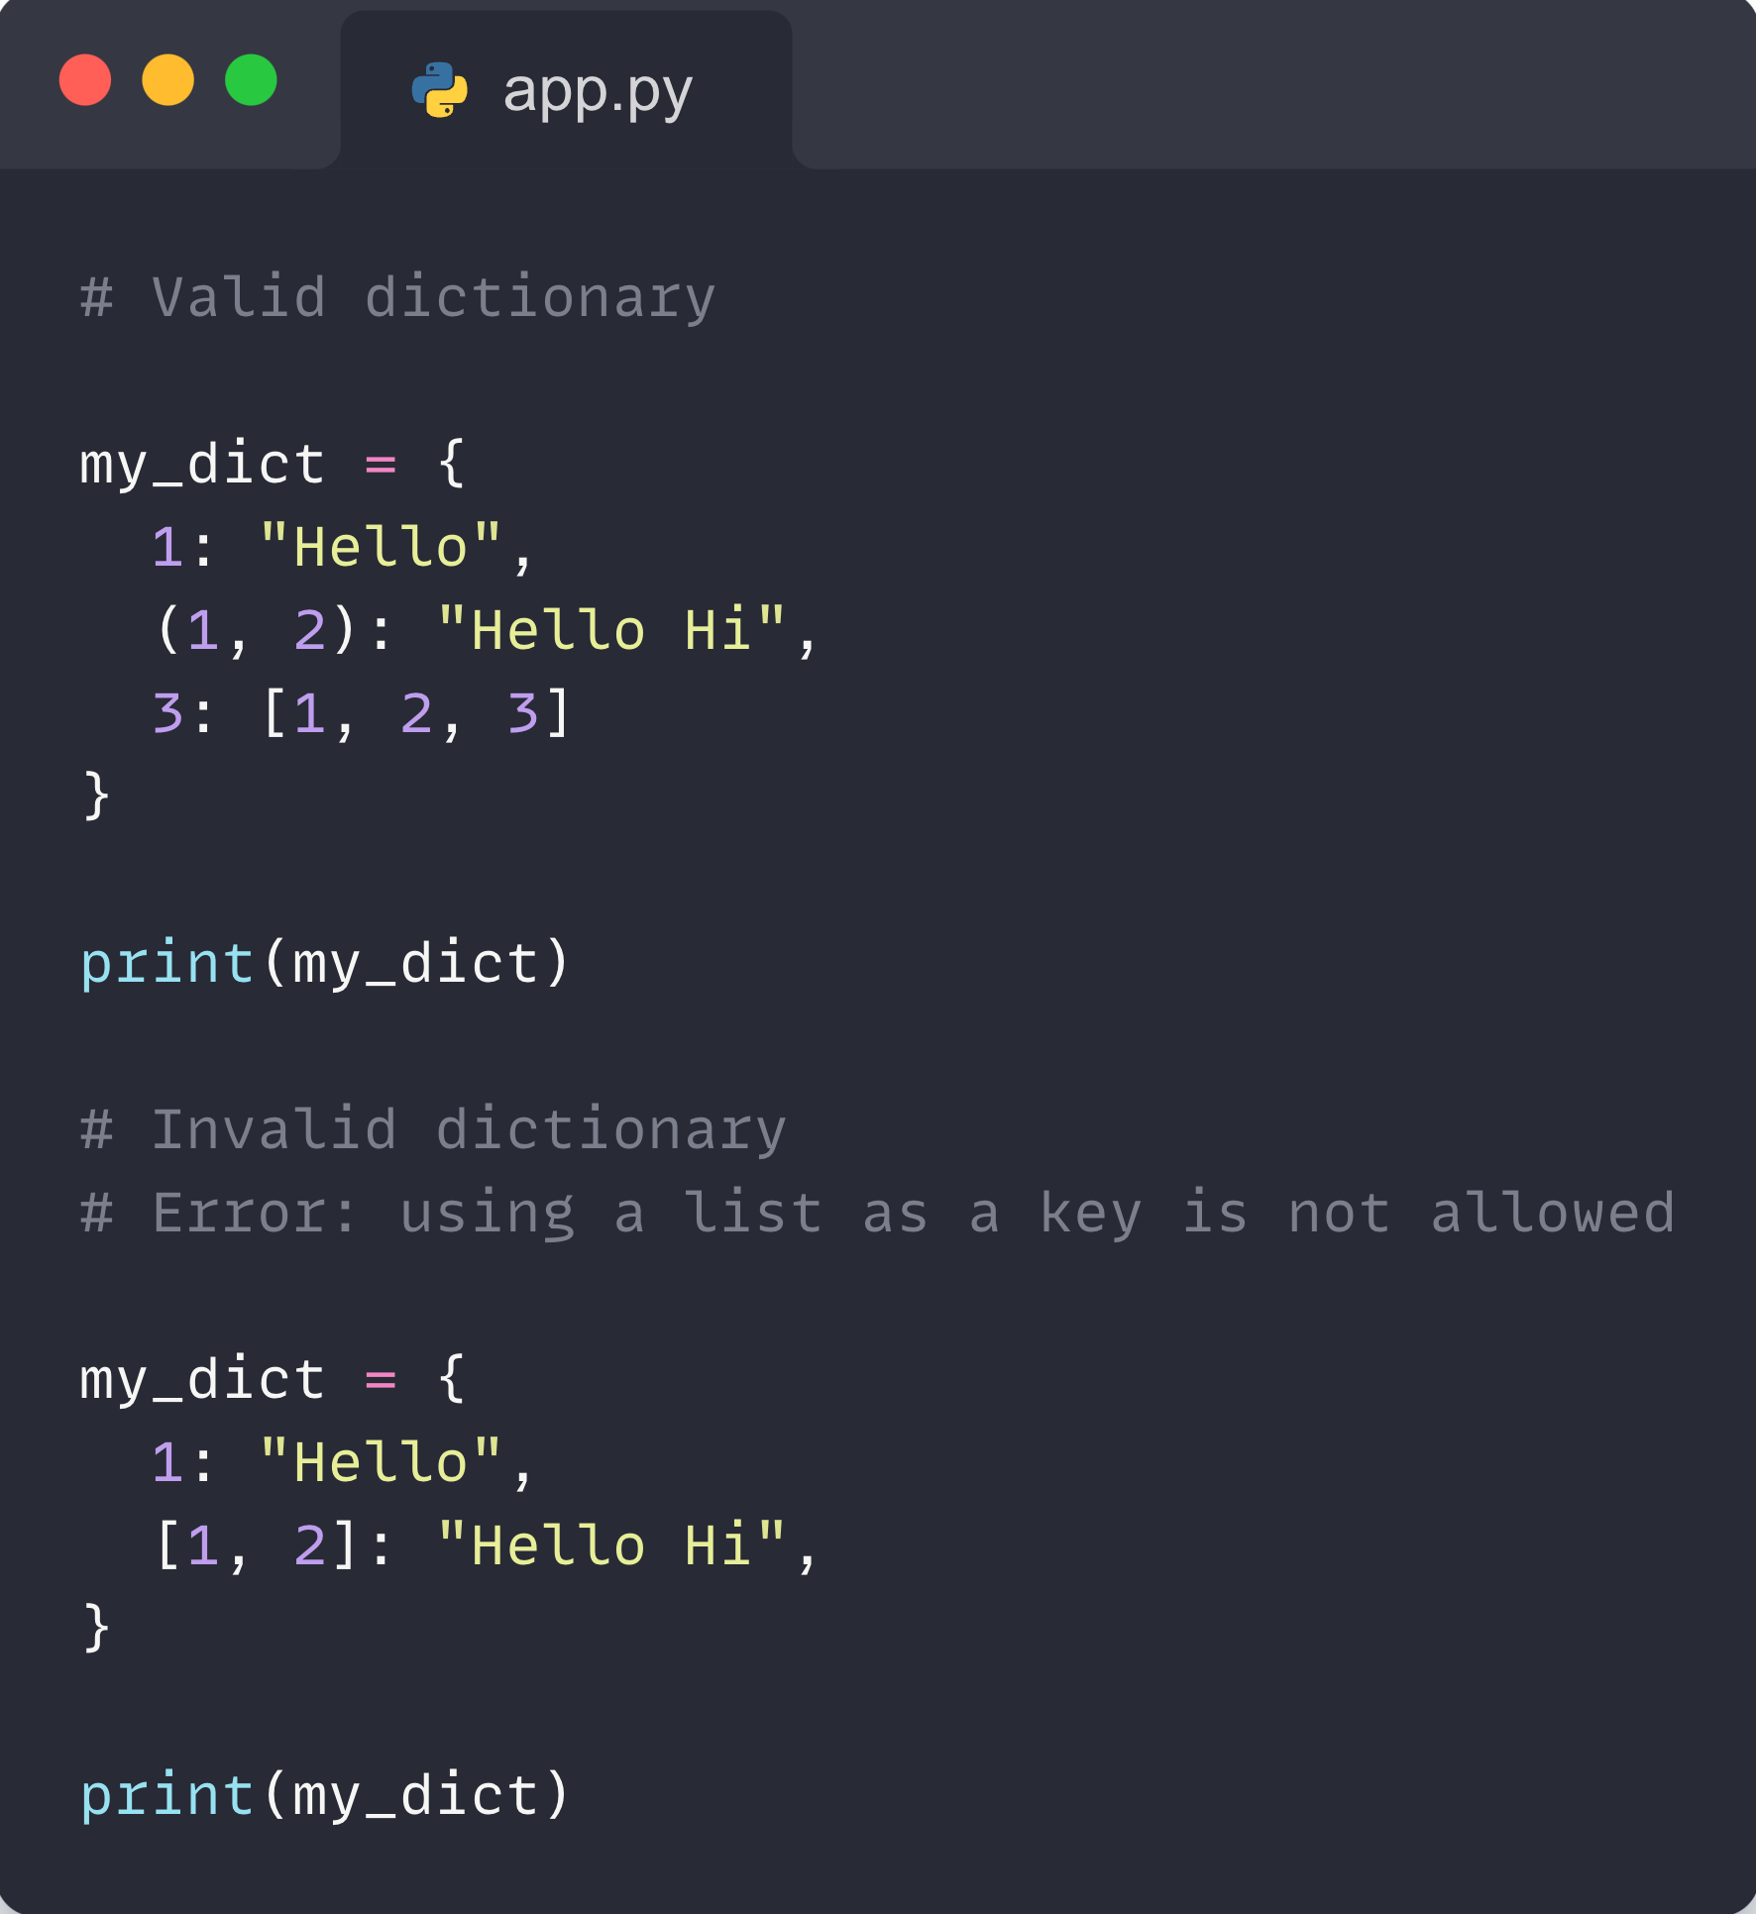
04- Dictionaries in python
Note :
Dictionary keys must be immutable, such as tuples, strings, integers, etc. We cannot use mutable (changeable) objects such as lists as keys.
‹#›

Slide 48
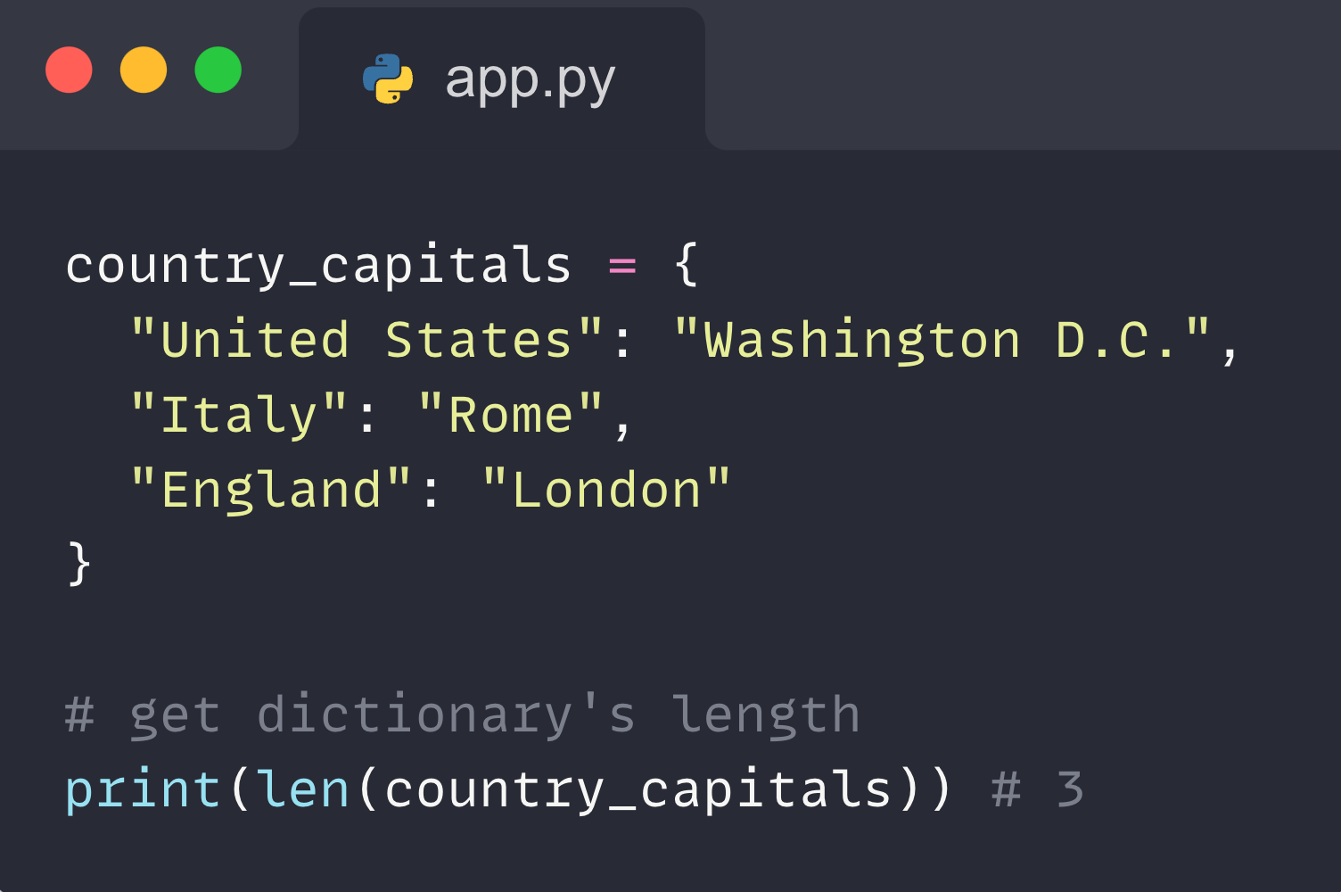
04- Dictionaries in python
Python Dictionary Length :
We can get the size of a dictionary by using the len() function.
‹#›

Slide 49
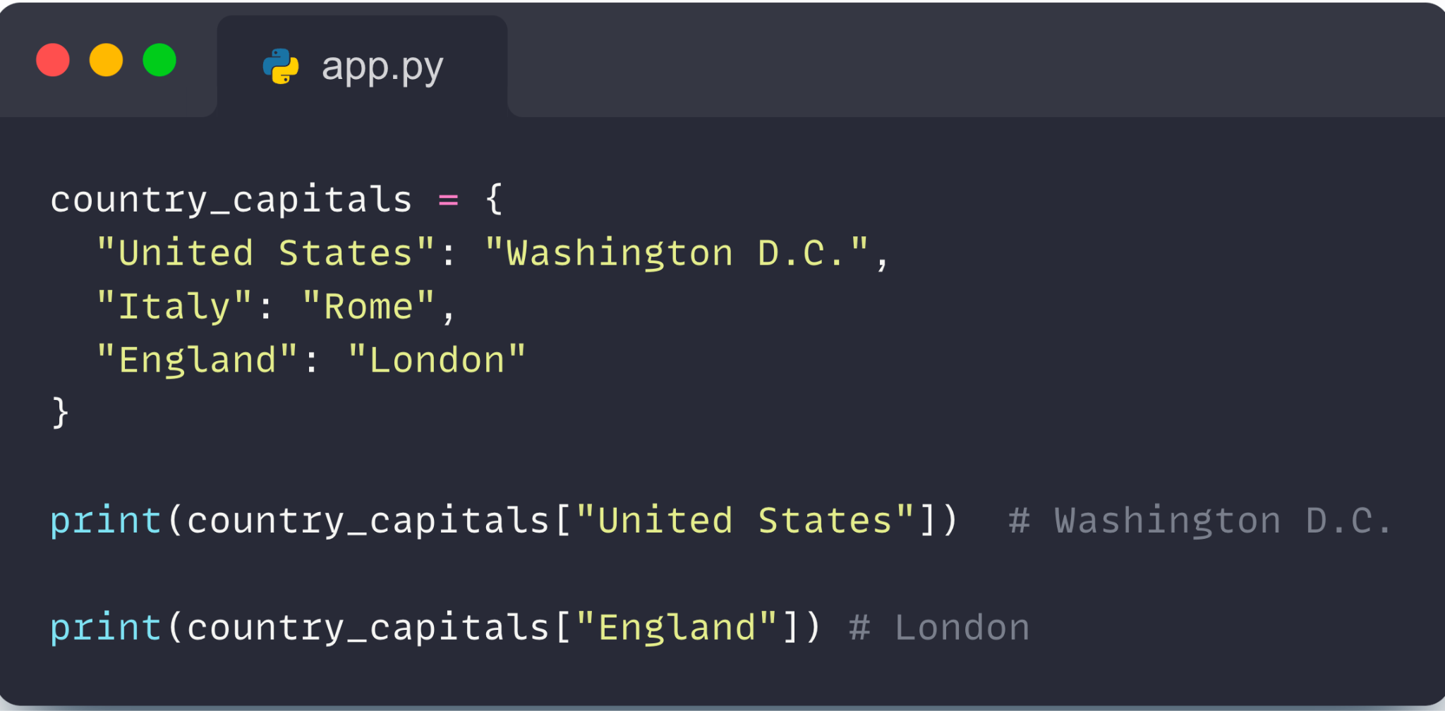
04- Dictionaries in python
Access Dictionary Items :
We can access the value of a dictionary item by placing the key inside square brackets.
‹#›

Slide 50
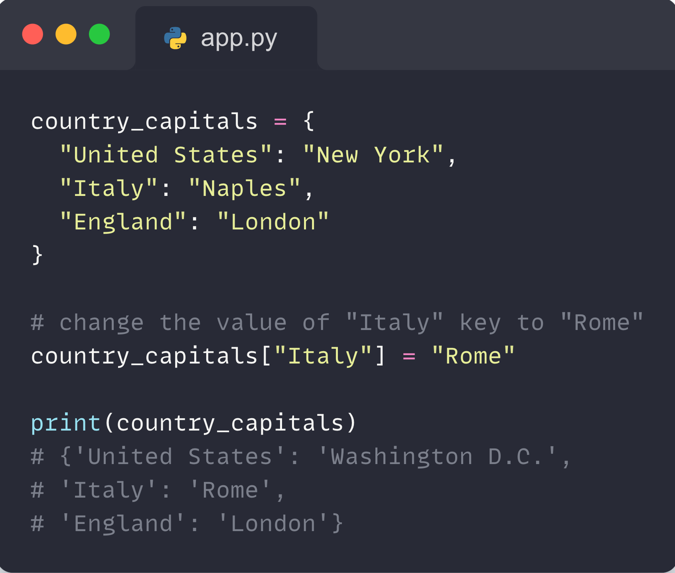
04- Dictionaries in python
Change Dictionary Items :
Python dictionaries are mutable (changeable). We can change the value of a dictionary element by referring to its key. For example,
‹#›

Slide 51
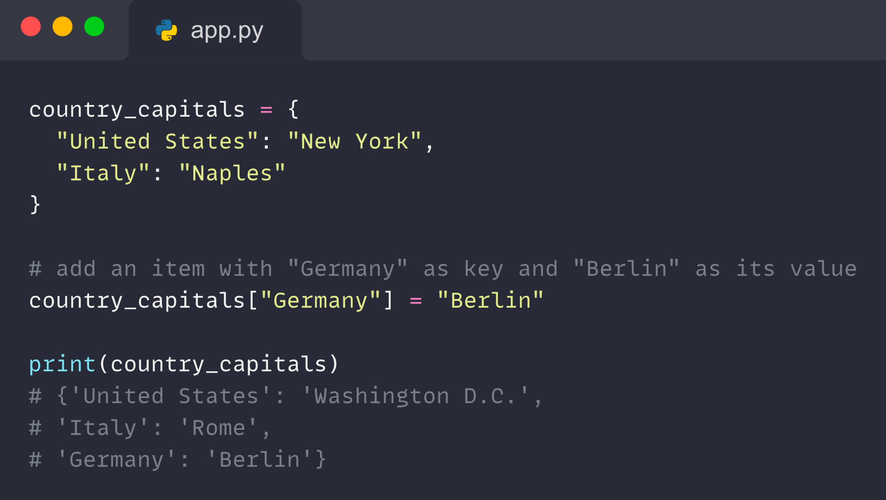
04- Dictionaries in python
Add Items to a Dictionary :
We can add an item to the dictionary by assigning a value to a new key (that does not exist in the dictionary). For example,
‹#›

Slide 52
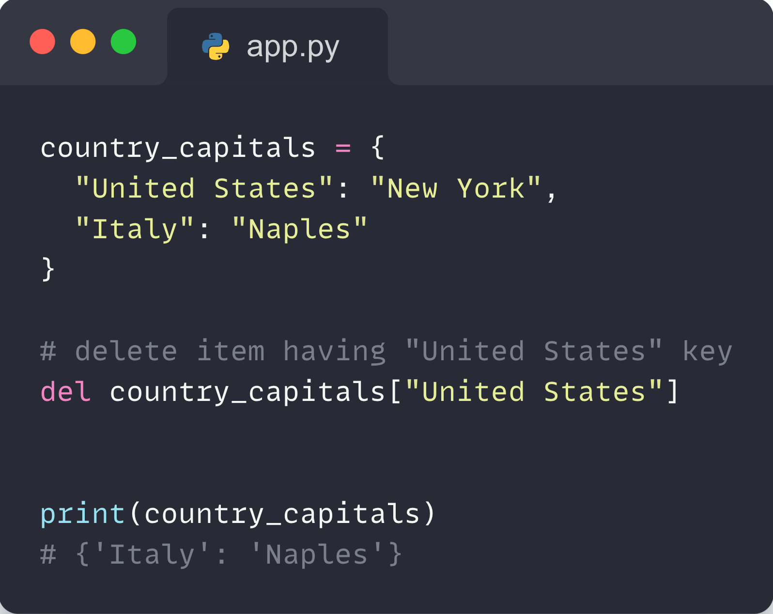
04- Dictionaries in python
Remove Dictionary Items :
We use the del statement to remove an element from the dictionary. For example,
‹#›

Slide 53
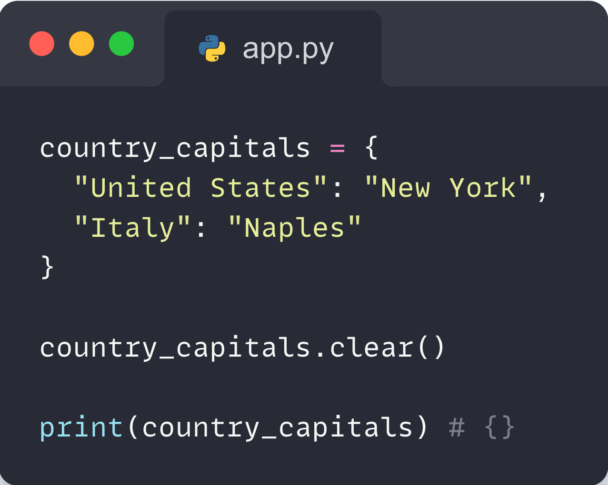
04- Dictionaries in python
If we need to remove all items from the dictionary at once, we can use the clear() method.
‹#›

Slide 54
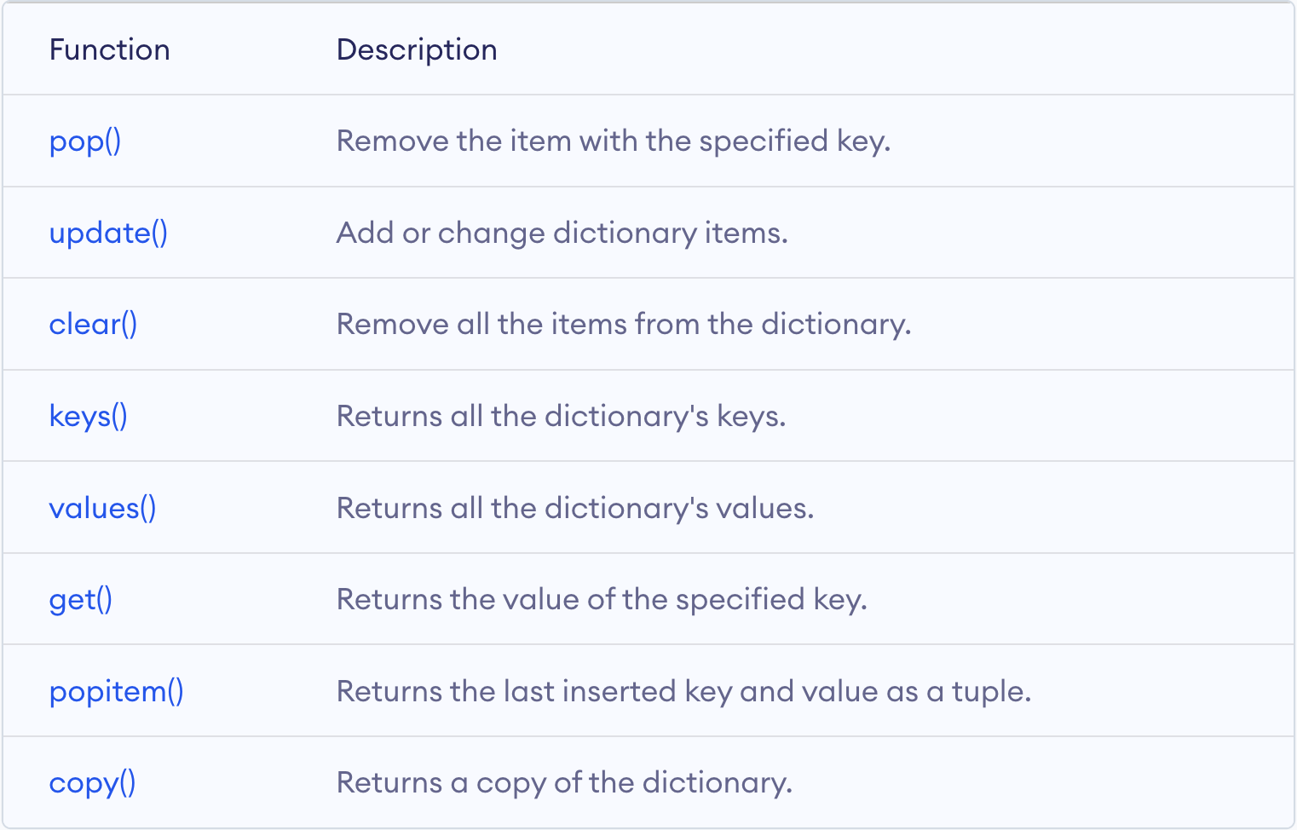
04- Dictionaries in python
Python Dictionary Methods :
‹#›

Slide 55
06
Exercises

Slide 56
05- Exercises
Tuples :
Exercise 1: Swap Elements of Two Tuples
Create a program that takes two tuples, each containing three elements. Your task is to swap the first and last elements of the first tuple with the second and third elements of the second tuple, and vice versa. Return the new tuples.
Exercise 2: Tuple Rotation
Write a function that takes a tuple and a positive integer n as inputs. The function should return a new tuple where the elements are rotated to the right by n positions. For example, if the input tuple is (1, 2, 3, 4) and n is 2, the function should return (3, 4, 1, 2).
‹#›

Slide 57
05- Exercises
Exercise 3: Frequency of Elements in a Tuple
Given a tuple containing integers, strings, or a mix of data types, write a program that returns a dictionary where the keys are the unique elements from the tuple, and the values are the number of times each element appears in the tuple. Do not use any external libraries or built-in functions that directly solve this task.
‹#›

Slide 58
05- Exercises
Sets :
Exercise 1: Set Intersection
Write a program that takes two sets of integers from the user and finds and prints the intersection of these sets. (Hint: You may use the & operator or the intersection method.)
Exercise 2: Unique Elements from Lists
Ask the user for two lists of integers and create two sets from them. Write a program that finds and prints the unique elements that are present in the first set but not in the second, and vice versa.
‹#›

Slide 59
05- Exercises
Exercise 3: Frequency Count
Given a list of integers, write a program that creates a set from the list, then calculates and prints the frequency of each element in the set. You should also display the element in the set with the highest frequency. (Hint: Consider using the Counter from the collections module for frequency counting.)
‹#›

Slide 60
05- Exercises
Lists :
Exercises 1: Remove Duplicates:
Given a list of integers, create a new list that contains only the unique elements of the original list in the same order they were encountered. Do this without using any built-in Python functions or data structures designed for this purpose.
Exercise 2: Rotate Elements:
Given a list and a number n, rotate the list to the left by n places. For instance, given the list [1, 2, 3, 4, 5] and n = 2, the resulting list should be [3, 4, 5, 1, 2].
‹#›

Slide 61
05- Exercises
Lists :
Exercises 3: Merge Alternating:
Given two lists of equal length, create a new list that consists of alternating elements from the two lists. For example, given the lists [1, 3, 5] and [2, 4, 6], the resulting list should be [1, 2, 3, 4, 5, 6].
‹#›

Slide 62
05- Exercises
Dictionaries :
Exercise 1: Dictionary Value Counter
Create a program that takes a dictionary as input, where the values are strings representing categories (e.g., colors, shapes, etc.), and returns a new dictionary with the categories as keys and the counts of occurrences as values.
Exercise 2: Merge Dictionaries
Write a function that takes two dictionaries as input. Both dictionaries have string keys, and the values are lists of numbers. Your function should merge the dictionaries by keys. If a key exists in both dictionaries, combine the lists of numbers. Ensure the numbers in the final lists are unique and sorted in ascending order.
‹#›

Slide 63
05- Exercises
Dictionaries :
Exercise 3: Nested Dictionary Query
Create a program that handles a nested dictionary, representing a hierarchy of employees in a company. The program should allow users to query an employee's information by name, and then print the information for that employee and all their subordinates (who are also represented by nested dictionaries). If the employee is not found, provide a suitable error message.sure the numbers in the final lists are unique and sorted in ascending order.
‹#›

Slide 64
Thank you

